Slide 1
Implementation of a Real-Time Score management System through Umpire signal Recognition
GUIDED BY,
Mrs.G.Shobana,
Assistant Professor, ECE
Pragadheesh Adhityan V S (21BEC109)
Sree Veerabagu E (21BEC115)
IV – ECE B

Slide 2
Introduction
Currently, umpiring relies heavily on manual interpretation of visual signals, which can sometimes lead to miscommunication or delays while updating.
Umpires use a set of standard hand signals to communicate crucial decisions, but the process remains dependent on human accuracy and the spectators' ability to interpret these gestures in real time.
This project seeks to automate and streamline this communication, ensuring a more efficient and clear understanding of umpire calls throughout the game.

Slide 3
Problem Statement
Manual scorekeeping can introduce delays and errors, particularly during critical moments when umpire signals are vital.
Existing automated systems often fail to interpret these signals in real time, resulting in inconsistent score updates.
This highlights the need for a more reliable solution that can seamlessly deliver precise, real-time score updates during live events, improving accuracy and enhancing the experience for players, officials, and fans.

Slide 4
Objectives
To improve the accuracy for detecting the sports officials by using the strengths of YOLOv8 and MediaPipe.
To decrease the man made error while updating scores and make it automated.
To minimize the time and effort required for manual calculation and updating of scores.
To minimize the errors by scorers while tracking runs, wickets, extras, and sometimes even ball-by-ball commentary, increasing the risk of oversight or errors, especially in high-pressure situations.

Slide 5
Literature Survey:
 | Literature Survey - 1
Author: | A. Dey, S. Biswasa, L. Abualigah. (2024)
Title : | Umpire’s Signal Recognition in Cricket Using an Attention based DC-GRU Network
Journal/Conf.: | IJE TRANSACTIONS A: Basics Vol. 37 No. 04, (April 2024) 662-674
Inference: | The model with attention can recognize cricket umpire signals accuracy of 94.38% and F1 score of 0.96. It also introduces a new dataset (CUAVd) for training and testing the model, making it useful for real-time applications.
Challenges: | The drawback is the lack of variety in the dataset, such as signals from different angles, lighting, or backgrounds, which might make the model less effective in real-world situations.

Slide 6
Literature Survey:
 | Literature Survey – 2
Author: | Yeong-Min Ko,Aziz Nasridinov,So-Hyun Park
Title : | Real-Time AI Posture Correction for Powerlifting Exercises Using YOLOv5 and MediaPipe
Journal/Conf.: | IEEE Access-(Volume: 12),2024.
Inference: | Proposed the service using YOLOv5 and Mediapipe. They had made three main exercise such as bench press ,Squat, Deadlift. They proposed MPED dataset, collecting 3D joint data to classify and correct postures in real-time.
Challenges: | Proposed the dataset named MPED which consist of three main exercise only named bench press, squat, deadlift and even more exercise can be added for full body workout.

Slide 7
Literature Survey:
 | Literature Survey – 3
Author: | A. Suryavanshi, S. Mehta, et al. (2024)
Title : | Cricket Umpire Intelligence: A CNN-SVM Framework for Action Detection
Journal/Conf.: | IEEE 2nd World Conference on Communication & Computing (WCONF) Raipur, India. Jul 12-14, 2024
Inference: | The paper effectively integrates CNN and SVM to achieve high accuracy in detecting cricket umpire signals. Introduces a dataset of 504 videos and 2,000 images This hybrid approach provides an accuracy of 85.89% and F1-Score of 0.90.
Challenges: | Creating a diverse dataset, handling class imbalance, and preventing overfitting. Combining CNN and SVM required careful tuning for real-time performance.

Slide 8
Literature Survey:
 | Literature Survey – 4
Author: | S. Sakib,Md. Afranul, et al. (2022)
Title : | Event Detection from Cricket Videos
Journal/Conf.: | IEEE Xplore-2022,4th International Conference on Sustainable Technologies for Industry 4.0 (STI),
Inference: | Proposes a method to detect key cricket events—FOUR, SIX, OUT, NO BALL, and WIDE—using a pre-trained I3D CNN. The model achieves 97.76% accuracy in frame detection and 86.14% in signal recognition, with precision, recall, and F1 scores of 95.23%, 86.95%, and 90.90%, outperforming image-based methods.
Challenges: | Requires additional data collection to extend its capabilities to these events. While the 3D CNN (I3D) approach has shown better performance compared to image-based methods, the model's effectiveness is more complex in video-based scenarios.

Slide 9
Literature Survey:
 | Literature Survey – 5
Author: | Andre Jallen S. Ong, Melvin Cabatuan , et al., (2022)
Title : | LSTM-Based Traffic Gesture Recognition Using MediaPipe Pose
Journal/Conf.: | IEEE region 10, Conference (TENCON),2022
Inference: | Uses a pose extraction algorithm called MediaPipe and an LSTM classification to determine and classify traffic gestures. This classification is able to be made in real-time. The frames were shown along with the MediaPipe pose key points and were used to generate the spatiotemporal arrays used to train the LSTM model.
Challenges: | More datasets need to be added for realistic real world implementations and the robustness need to be improved.

Slide 10
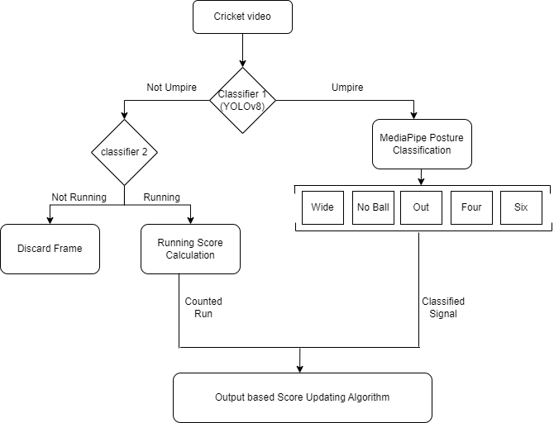
Flow Diagram:

Slide 11
YOLOv8:
YOLOv8 model is used for detection of Umpire within the frame
It will be acting as a classifier if the Umpire is detected then the frame is processed with MediaPipe framework for classification of the signal
If the umpire frame is not detected then the frame will be checked for running action, if found will go through that calculation else the frame is discarded
The model is trained with 528 images with umpire and non umpire class

Slide 12
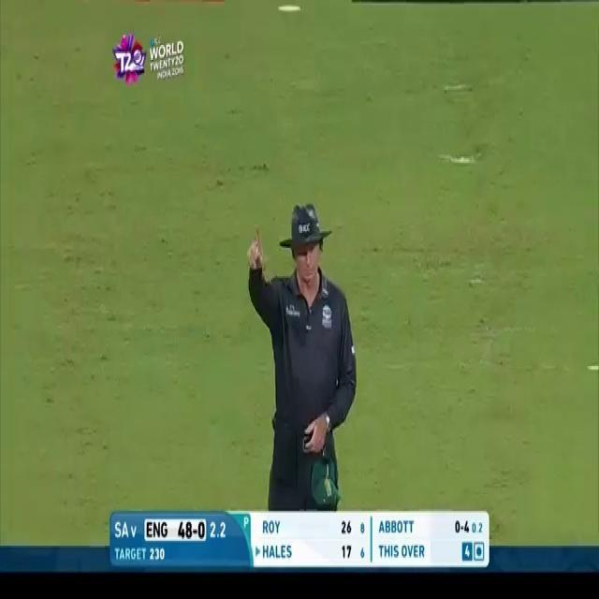
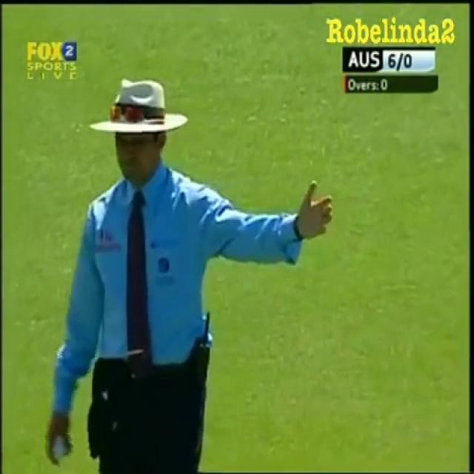
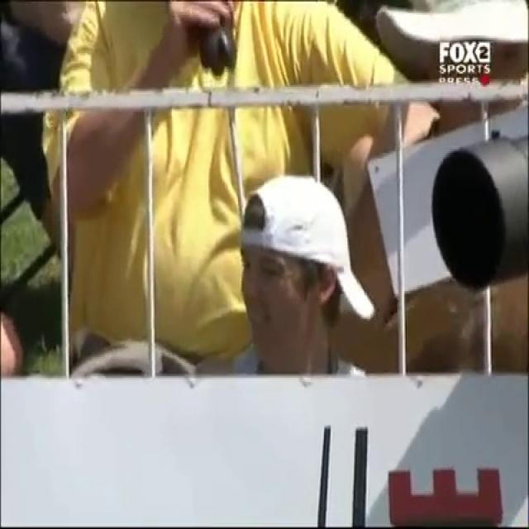
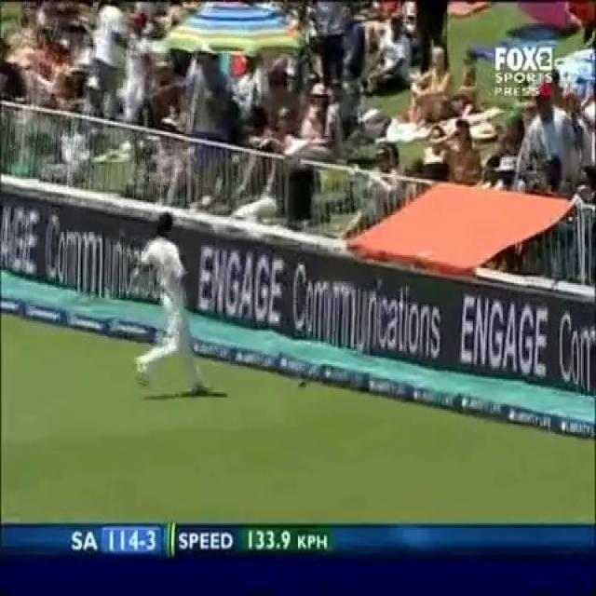
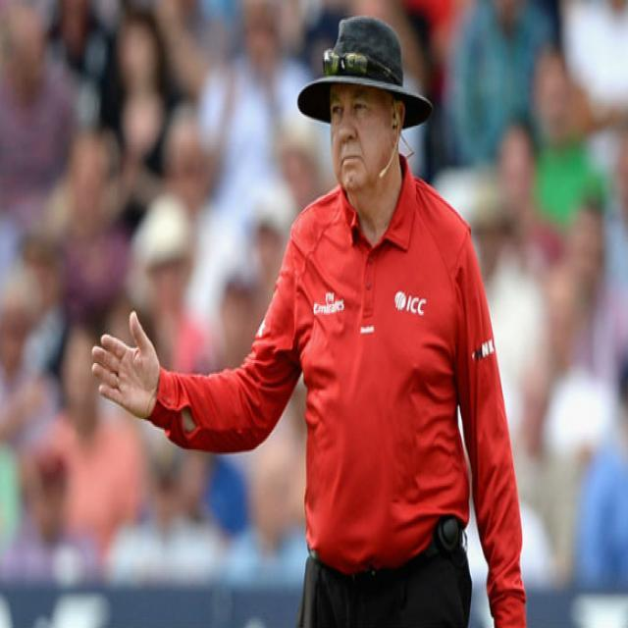
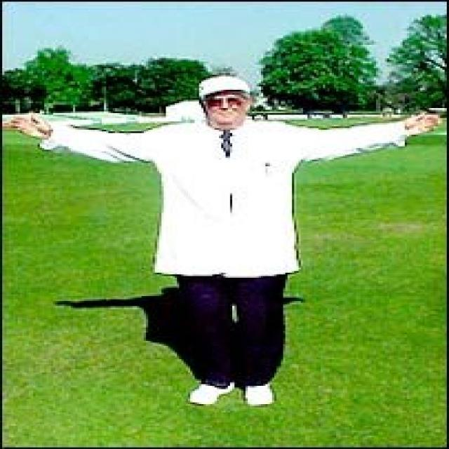
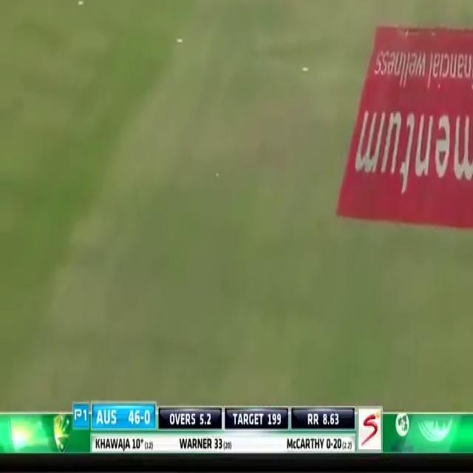
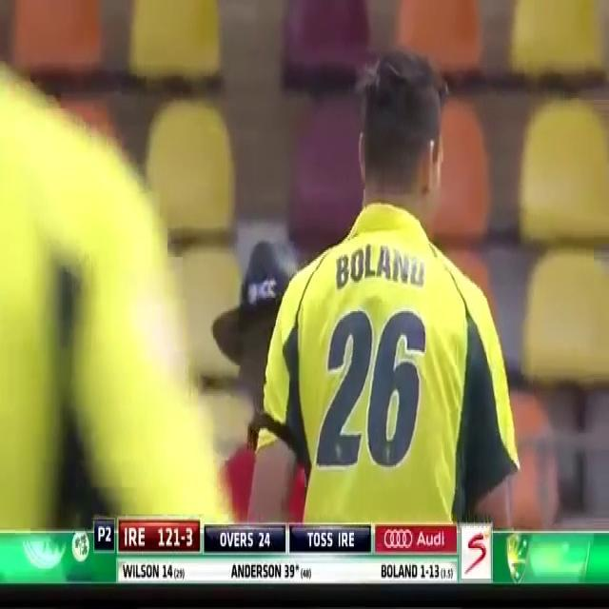
Sample Images:
Umpire Class
Non-Umpire Class

Slide 13
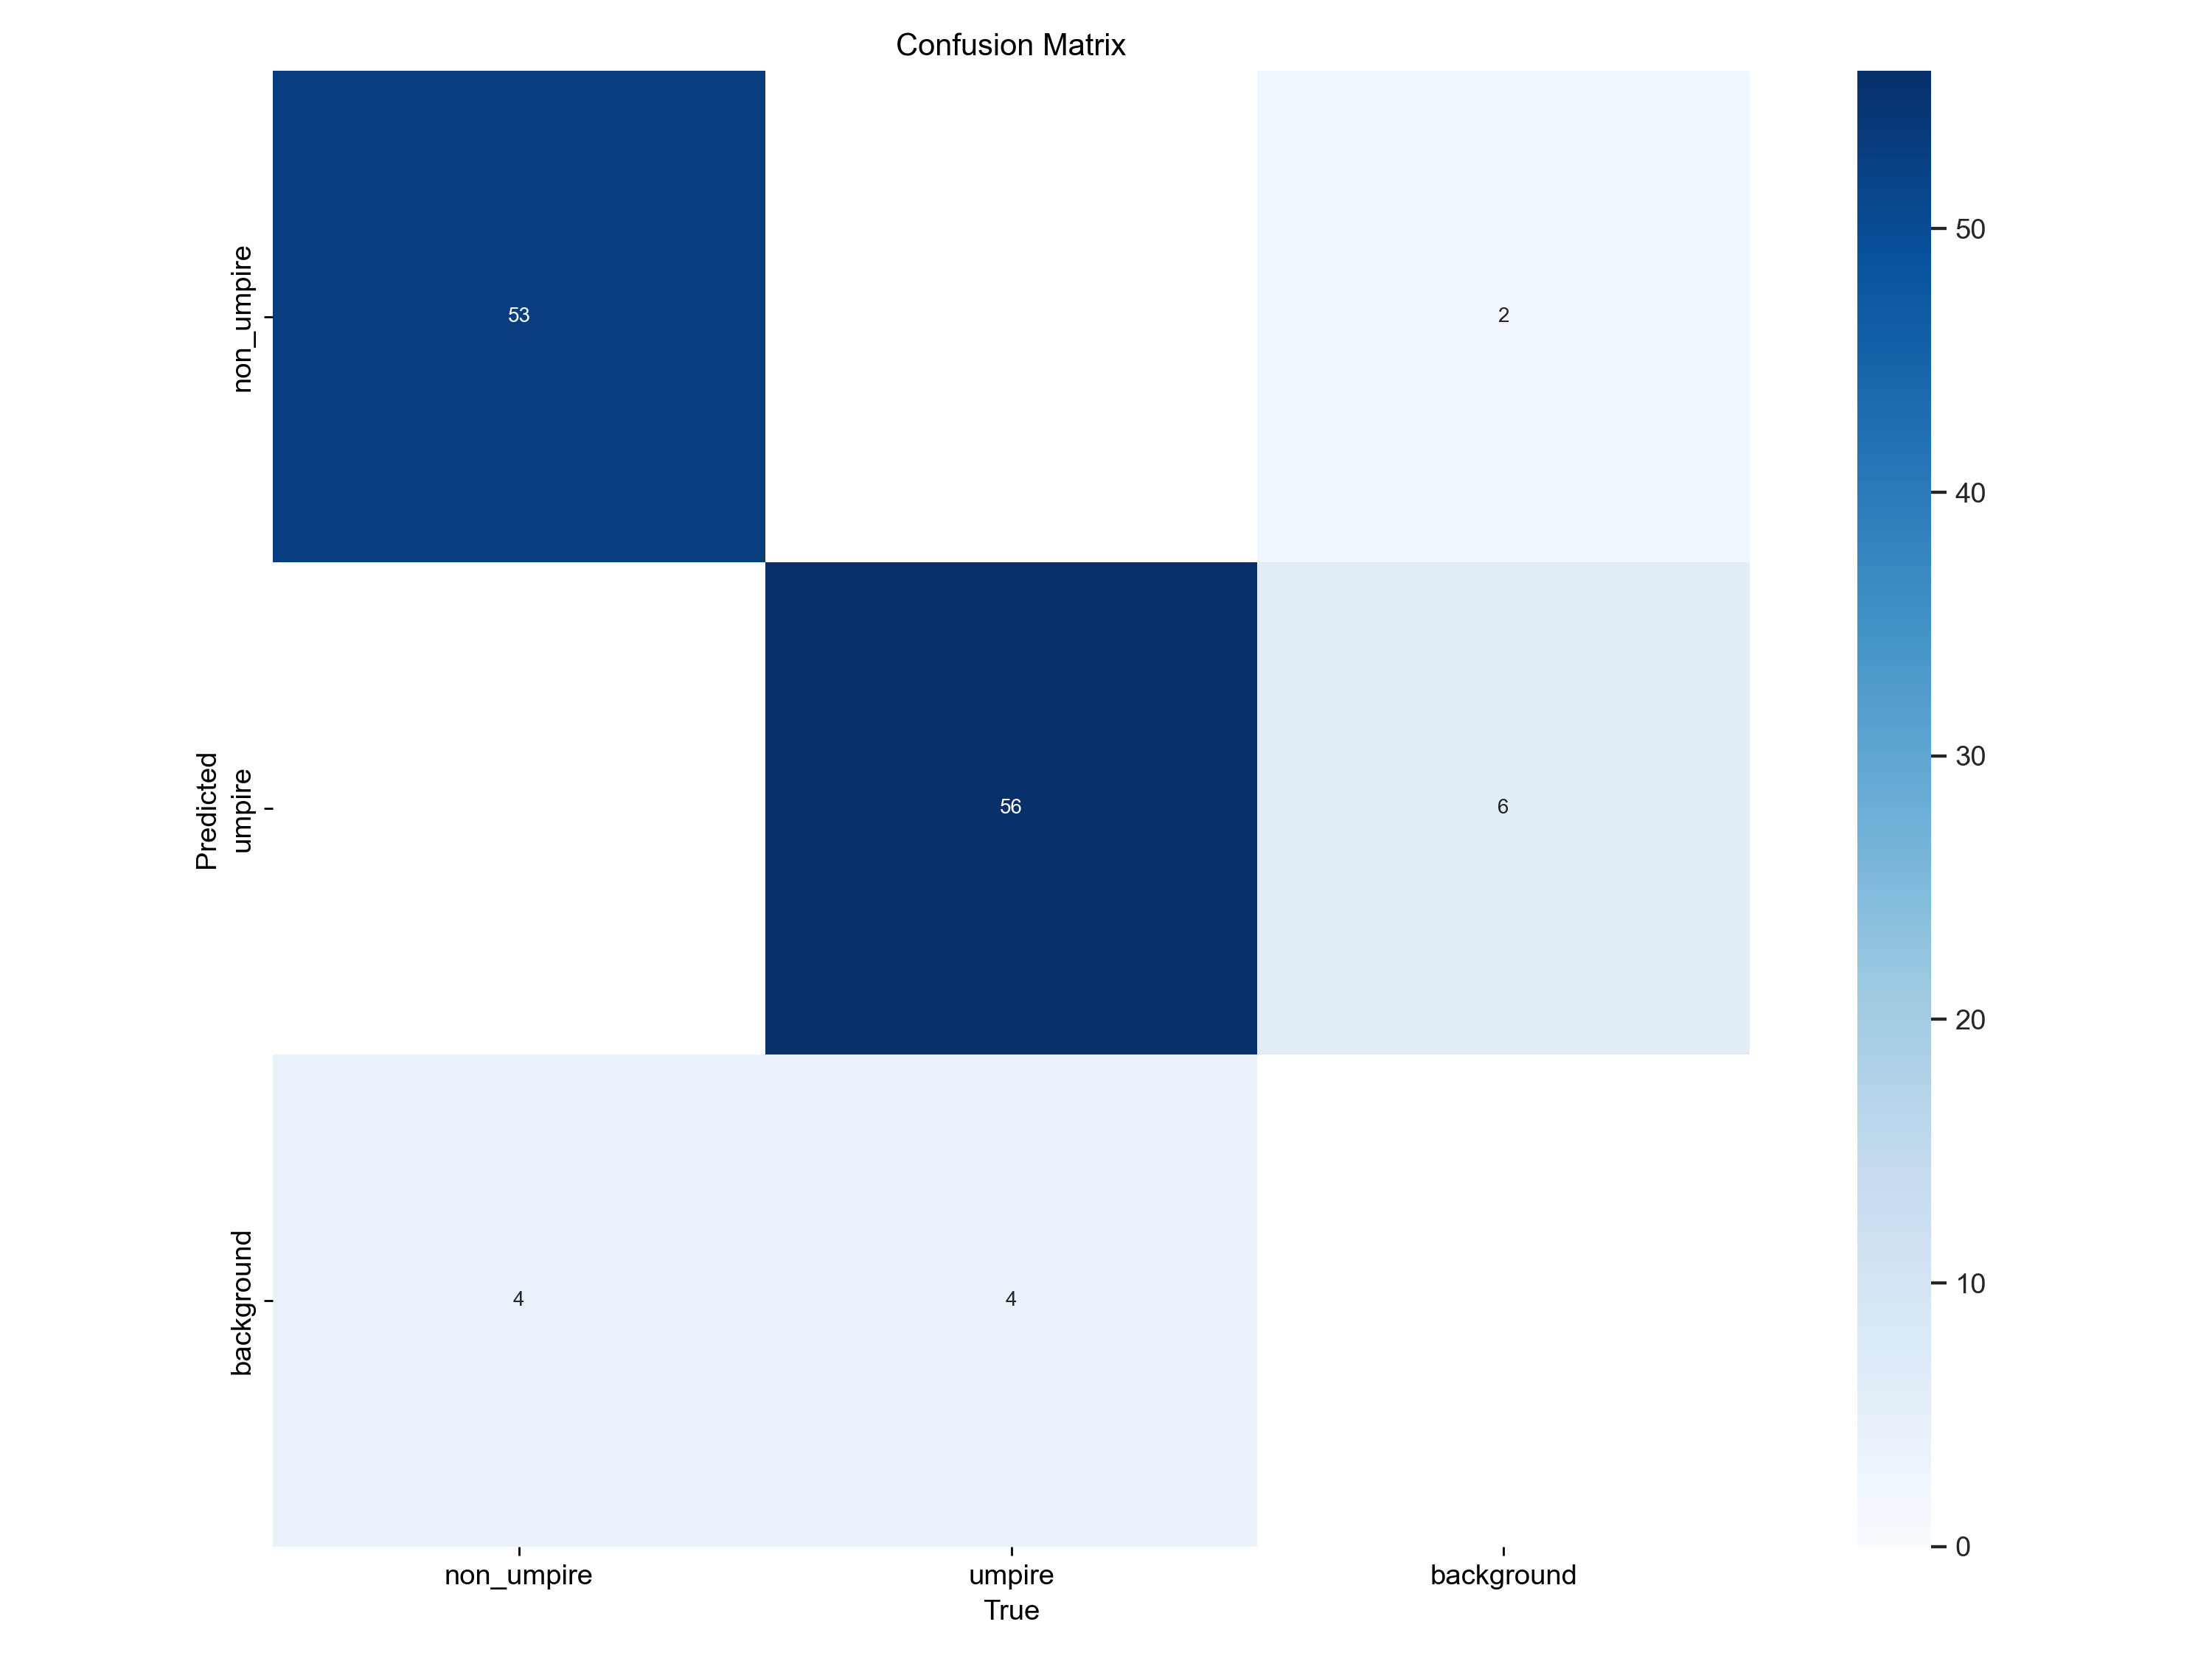
Confusion Matrix:
Epoch : 300
53
2
56
6
4
4

Slide 14
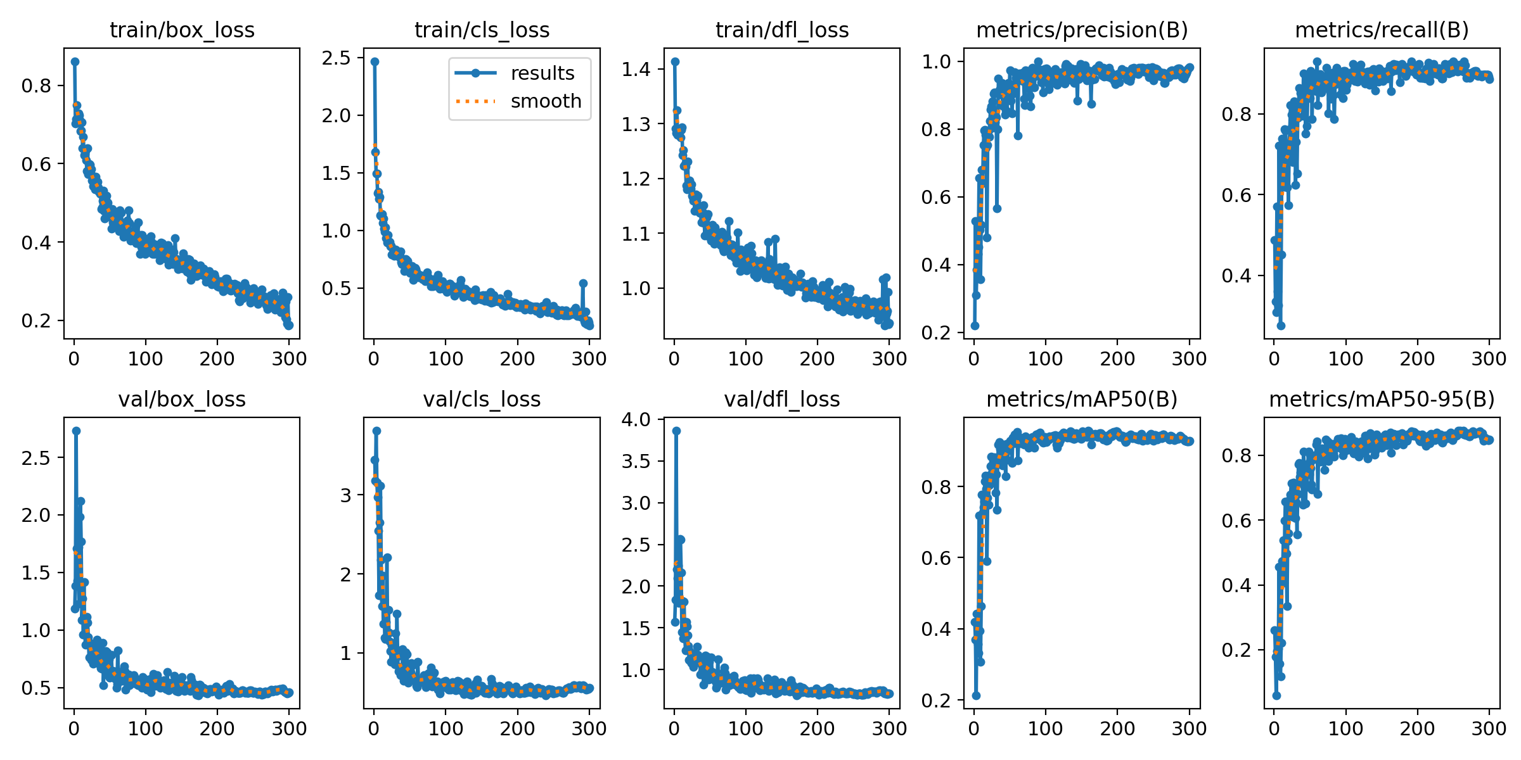
Performance results:

Slide 15
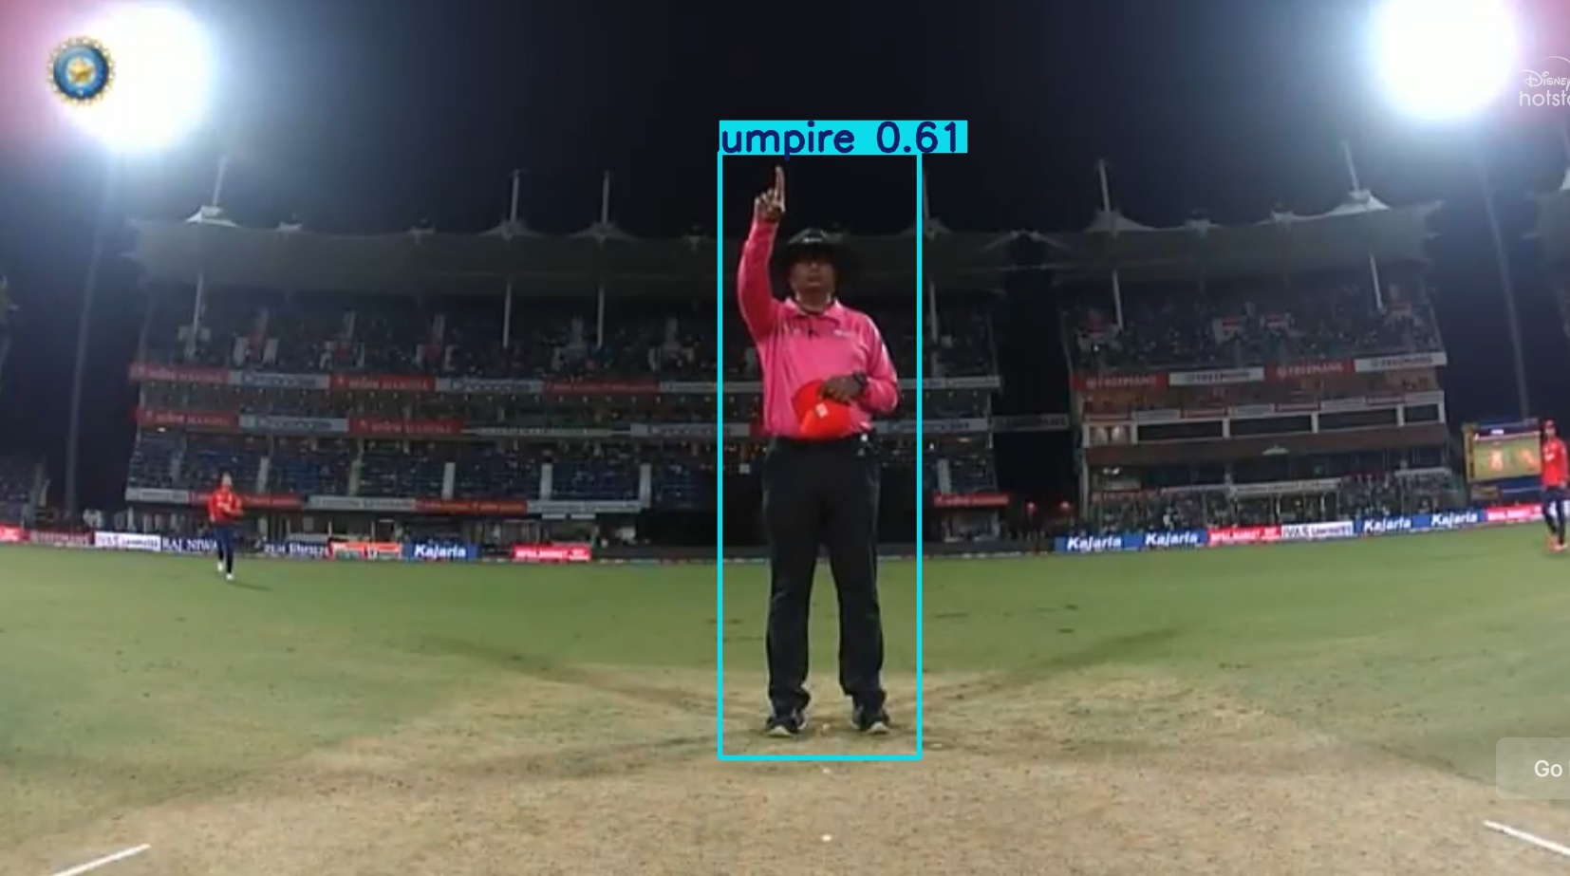
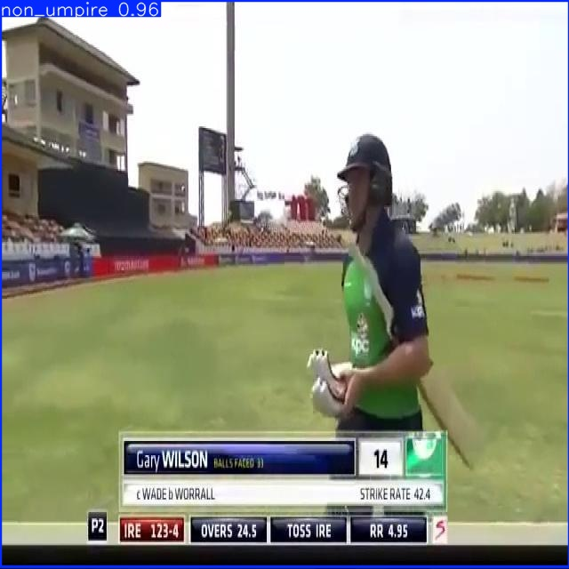
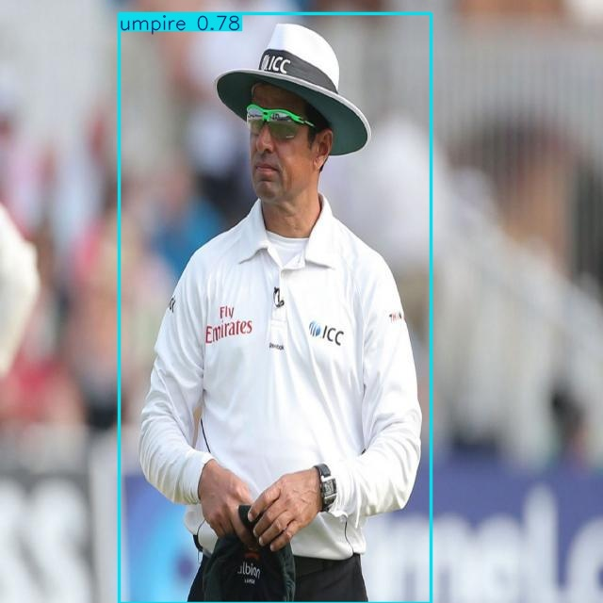
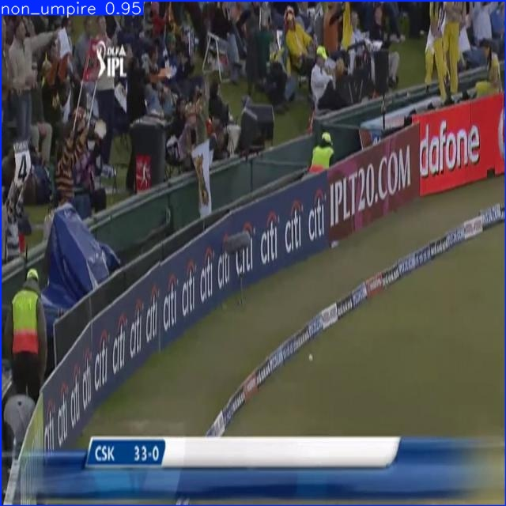
Output:

Slide 16
MediaPipe :
Web cam
Locate the model for Land marking
Determining the coordinates of tips
Output
Detection of correct posture
Determining the angles of inclinations
Exit

Slide 17
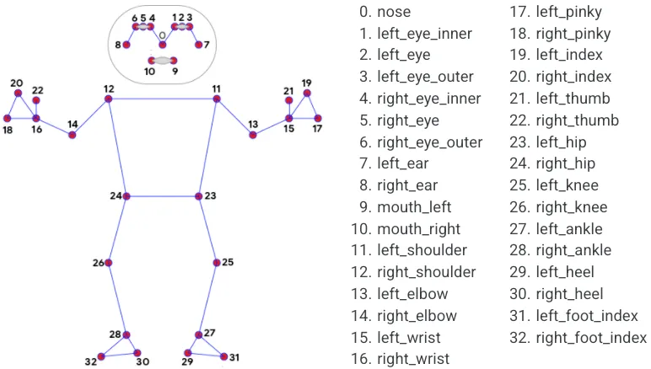

Coordinates of points:

Slide 18
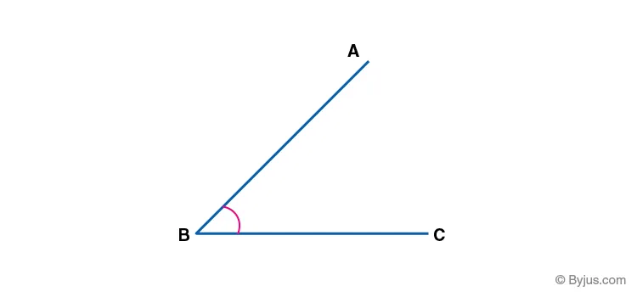
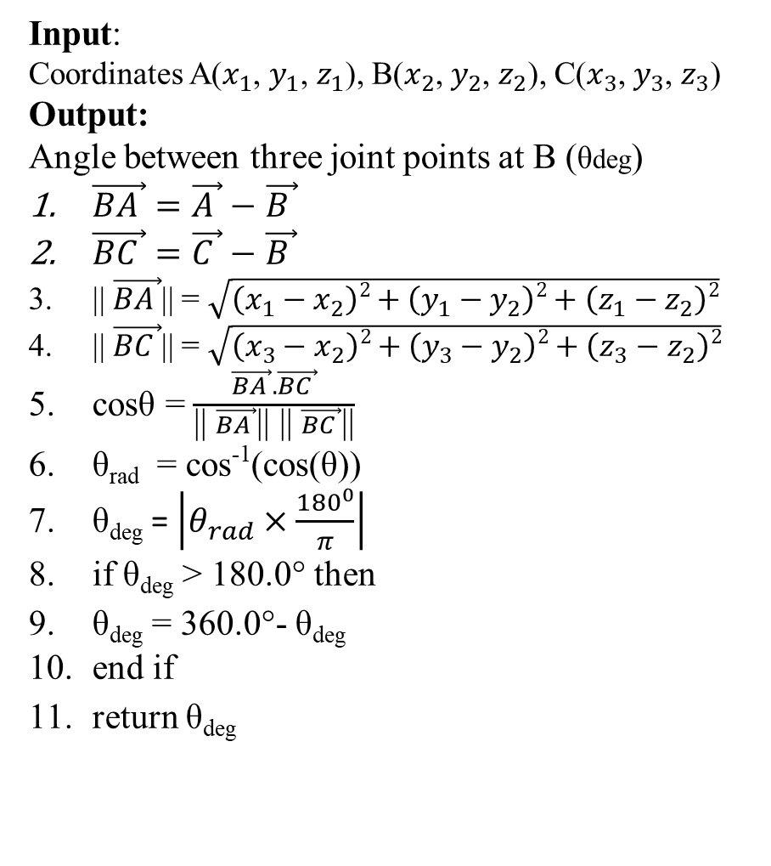
Determining the angles of inclinations (Methodology I):
Input:
Coordinates A($x_{1}$, $y_{1}$, $z_{1}$), B($x_{2}$, $y_{2}$, $z_{2}$), C($x_{3}$, $y_{3}$, $z_{3}$)
Output:
Angle between three joint points at B (θdeg)
$\vec{BA }=\vec{A }−$ $\vec{B }$
$\vec{BC }=\vec{C }−$ $\vec{B }$
|| $\vec{BA }$|| = $\sqrt{\left(x_{1}−x_{2}\right)2+\left(y_{1}−y_{2}\right)2+\left(z_{1}−z_{2}\right)2}$
|| $\vec{BC }$|| = $\sqrt{\left(x_{3}−x_{2}\right)2+\left(y_{3}−y_{2}\right)2+\left(z_{3}−z_{2}\right)2}$
cosθ = $\frac{\vec{BA }.\vec{BC }}{\text{||} \vec{BA }\text{|| ||} \vec{BC }\text{||}}$
θ_{rad} = cos⁻¹(cos(θ))
θ_{deg} = $\left|θ_{rad}×\frac{{180}^{0}}{π}\right|$
if θ_{deg} > 180.0° then
θ_{deg} = 360.0°- θ_{deg}
end if
return θ_{deg}

Slide 19
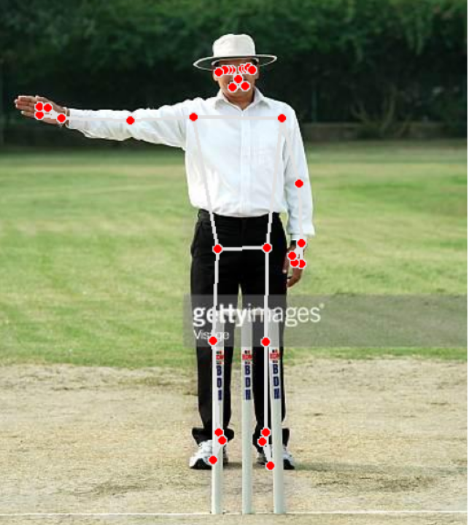
Mediapipe (Umpire signals) :
Angle (in degrees):
left_elbow_angle: 167.459035325295
right_elbow_angle: 174.96871710488
left_shoulder_angle: 21.3062613454
right_shoulder_angle: 97.2265536258
left_knee_angle: 179.3013056170168
right_knee_angle: 173.561260398890

Slide 20
MediaPipe (Angles’ range in Degree) :
Joints Umpire Signals | Left elbow | Right elbow | Left shoulder | Right shoulder | Left knee | Right knee
Wide | 100-180 | 100-180 | 40-100 | 40-100 | 160-180 | 160-180
No ball | 100-180 | 100-180 | 0-90 | 0-30 | 160-180 | 160-180
Six | 100-180 | 100-180 | 130-180 | 130-180 | 160-180 | 160-180
Revoke | 40-60 | 40-60 | 0-10 | 0-10 | 160-180 | 160-180
No signal | 90-180 | 90-180 | 0-30 | 0-30 | 160-180 | 160-180

Slide 21
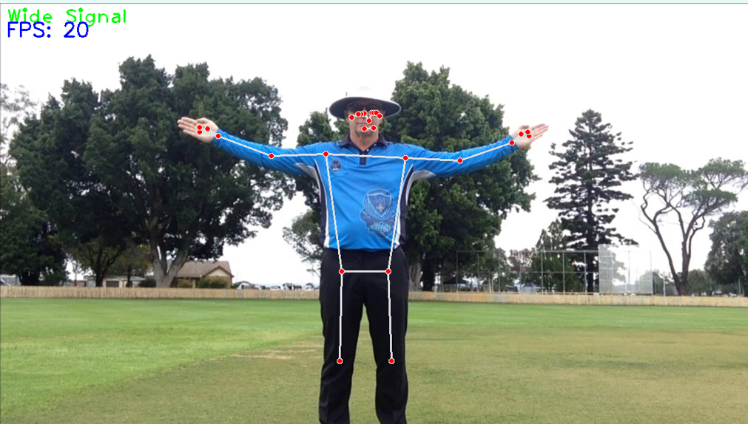
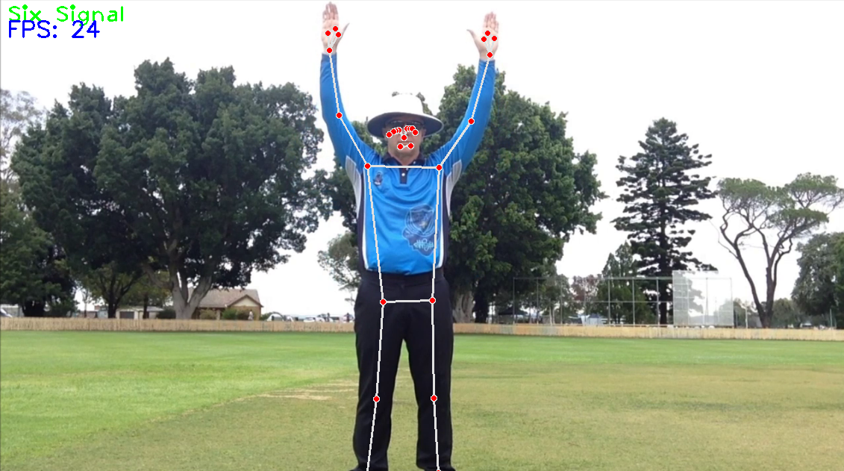
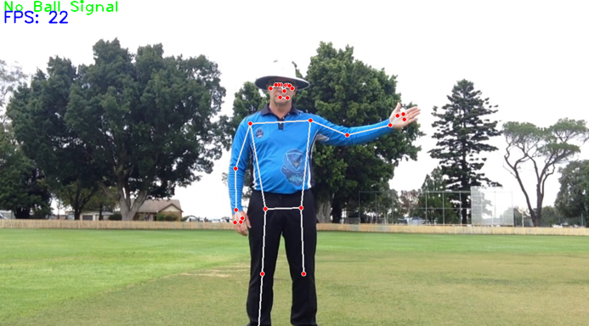
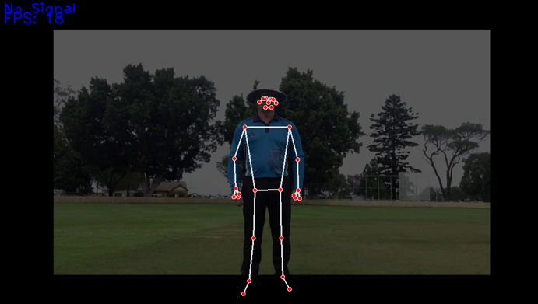
MediaPipe Output (Video Input):

Slide 22
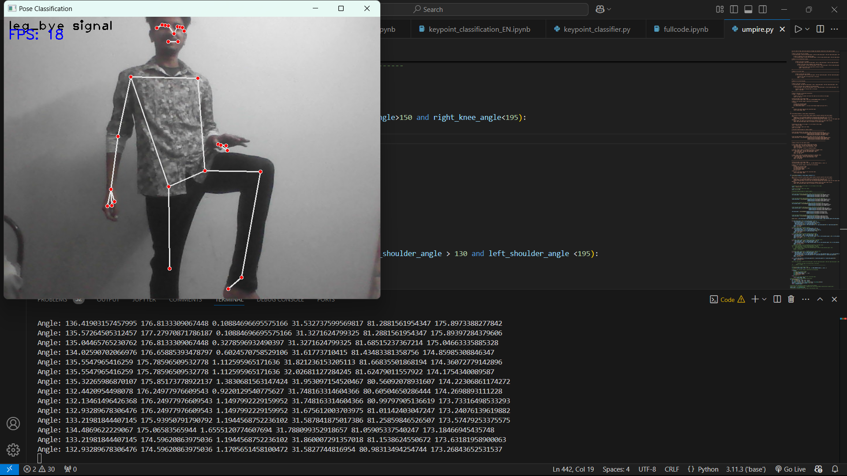
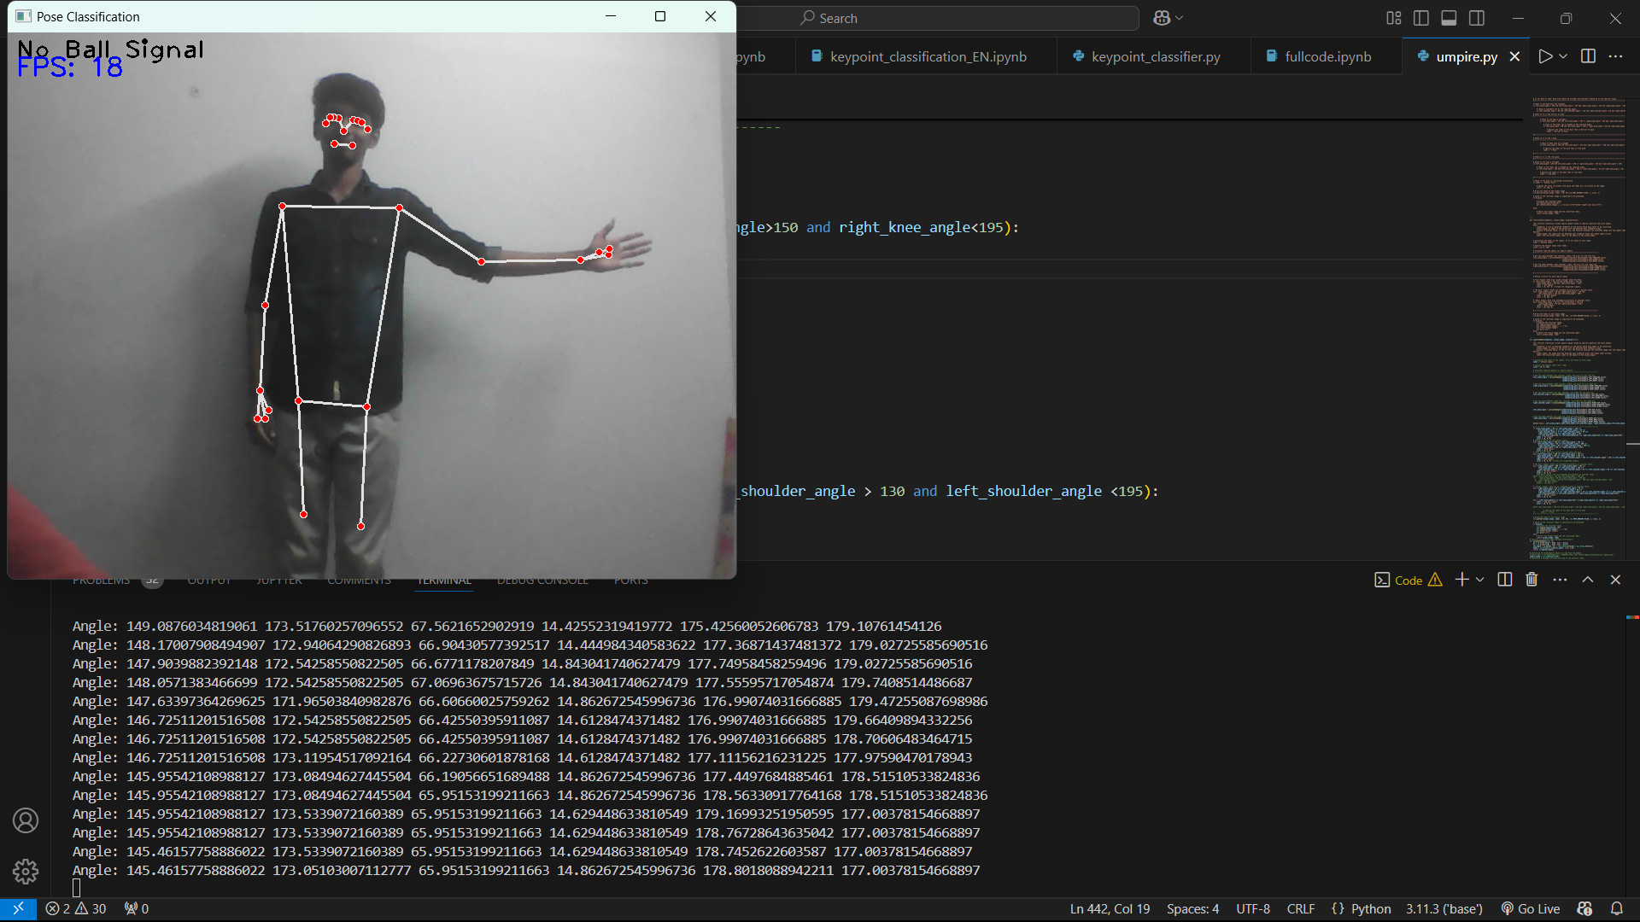
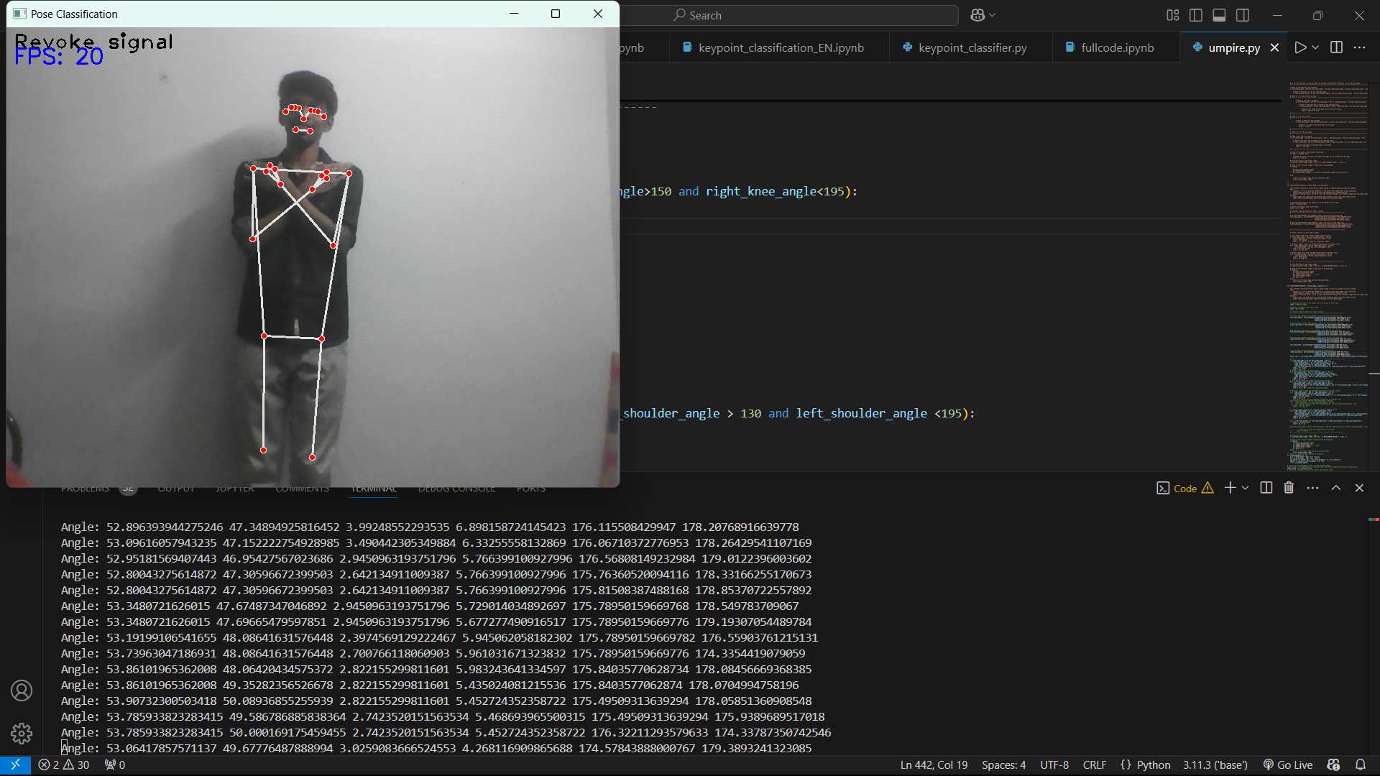
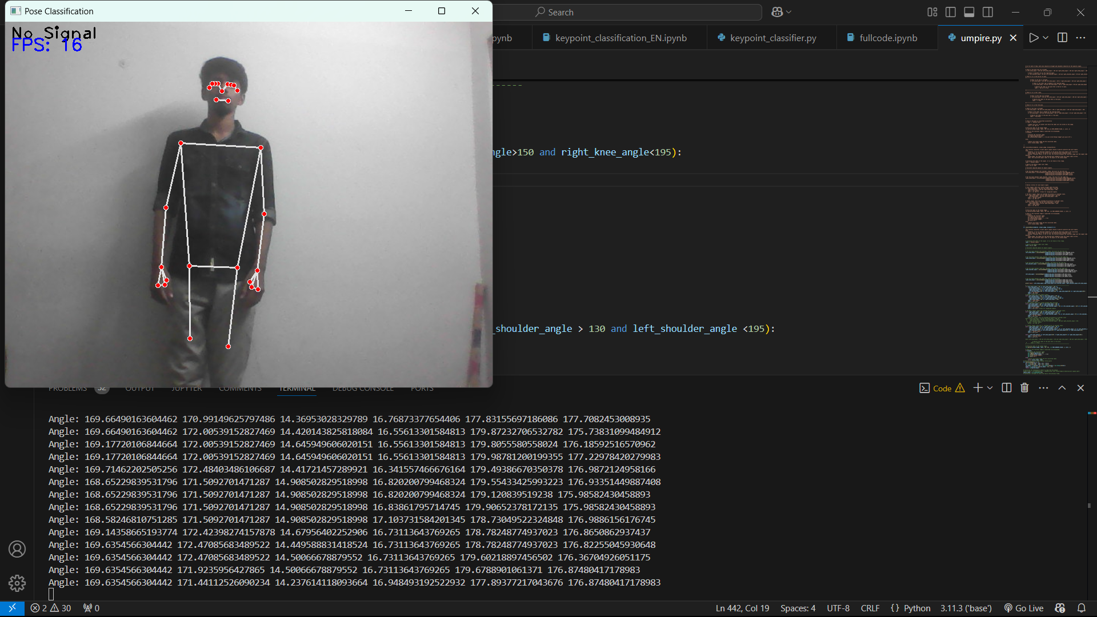
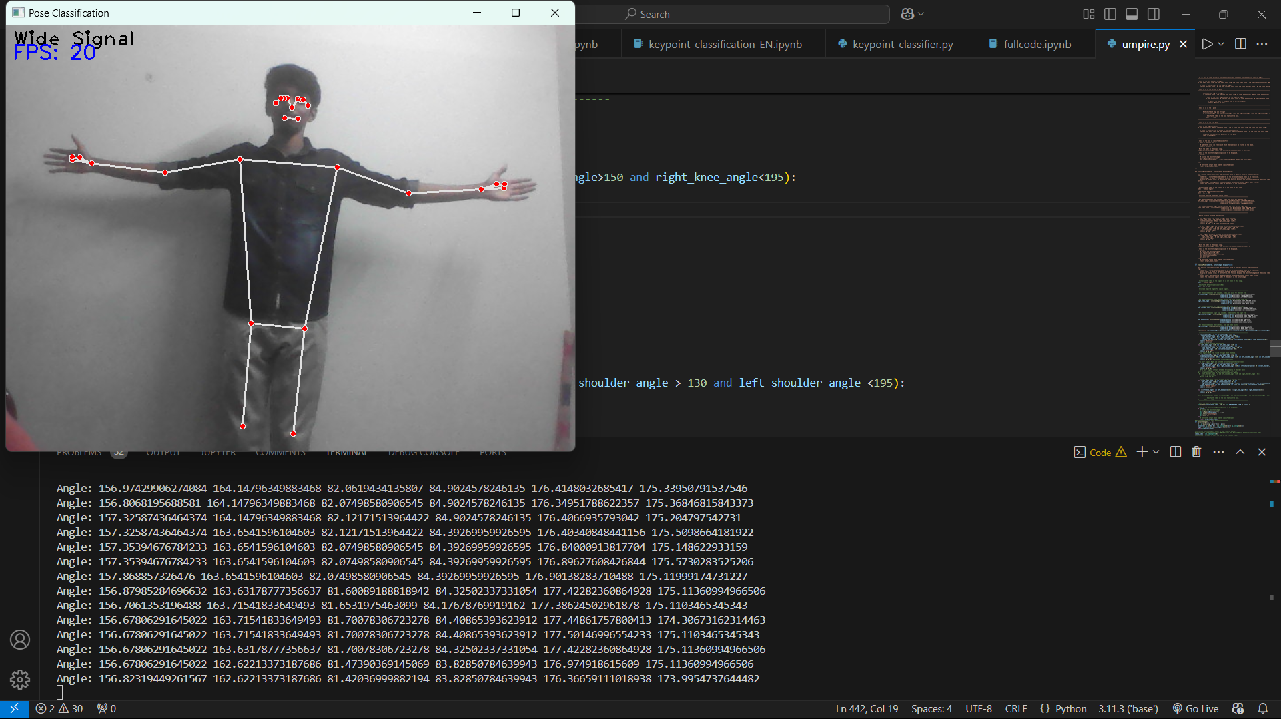
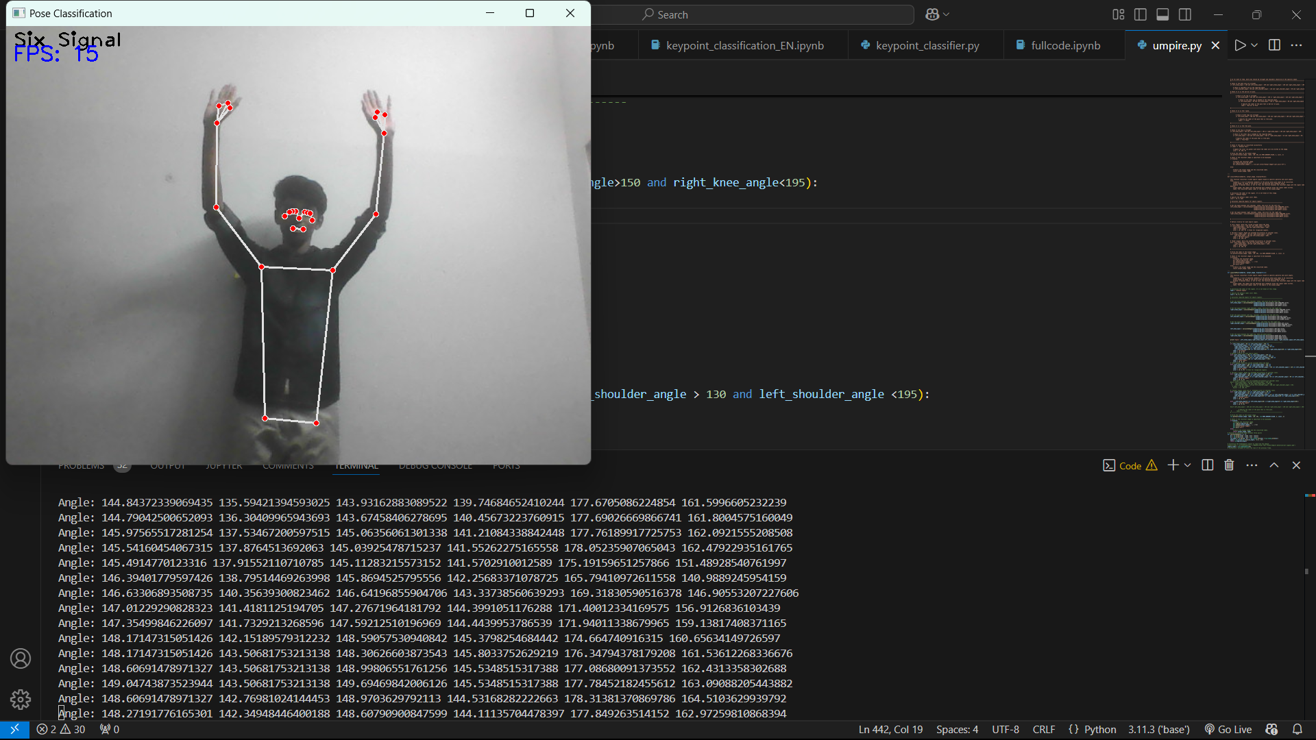
Real-Time Output: (Methodology:1)

Slide 23
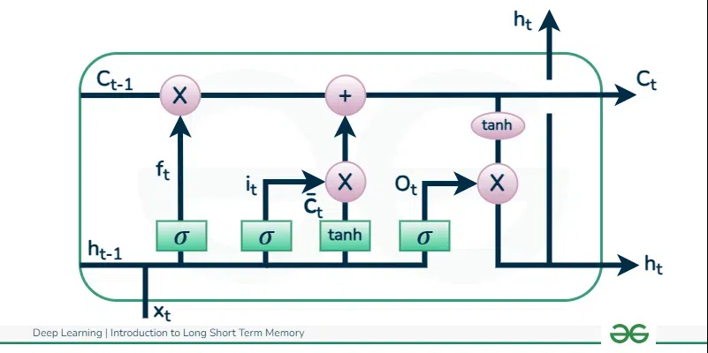
MediaPipe + LSTM (Methodology-2) :
As previous method rely on angles of the coordinates, it struggles to recognize dynamic signals, So LSTM is used to train both static and dynamic umpire poses
LSTM also studies the previous frame data to recognize continuous signals like four, free hit, review, etc.,
LSTM Architecture:
Ct – Cell State
Ct-1 – Previous Cell State
Ht – Hidden state
Ht-1 – Previous Hidden state
ft – Forget state
It – Input state
Ot – Output state

Slide 24
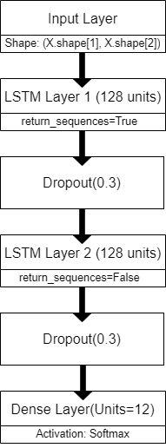
Architecture Used for Training:

Slide 25
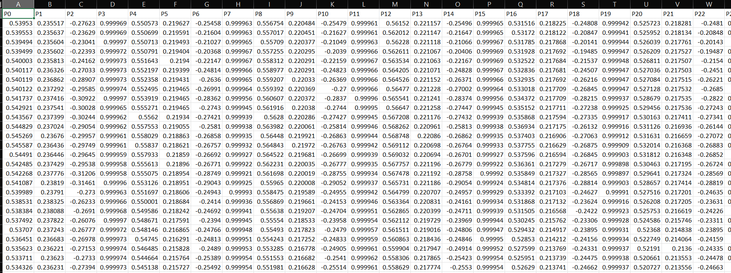
Dataset Details:
Created the Umpire MultiPose Dataset (UMPD) which contains the values of the position of the landmarks of the joints.
It consist of 12 umpire signal values which are been stored in .csv file with the help of MediaPipe where the values of both hand and Pose are stored.

Slide 26
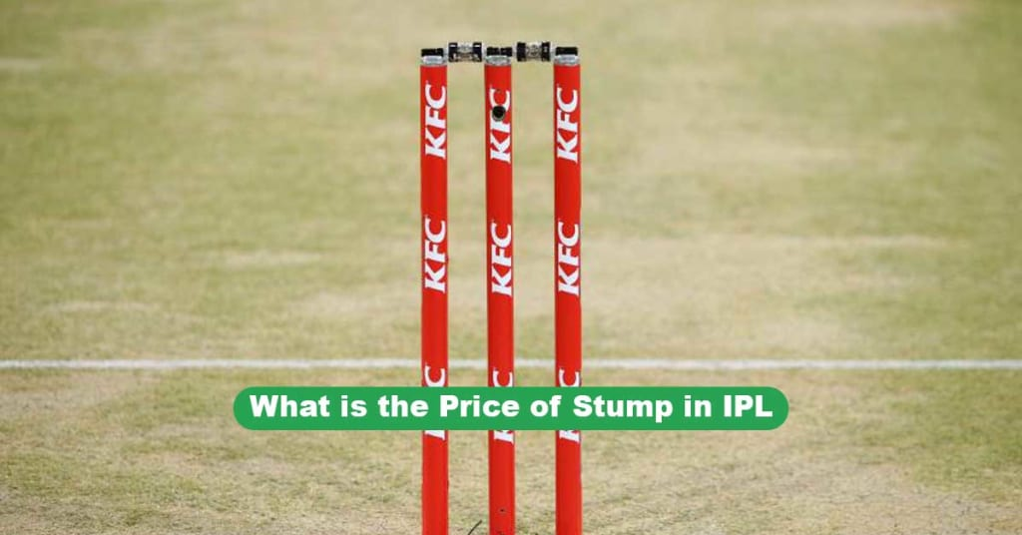
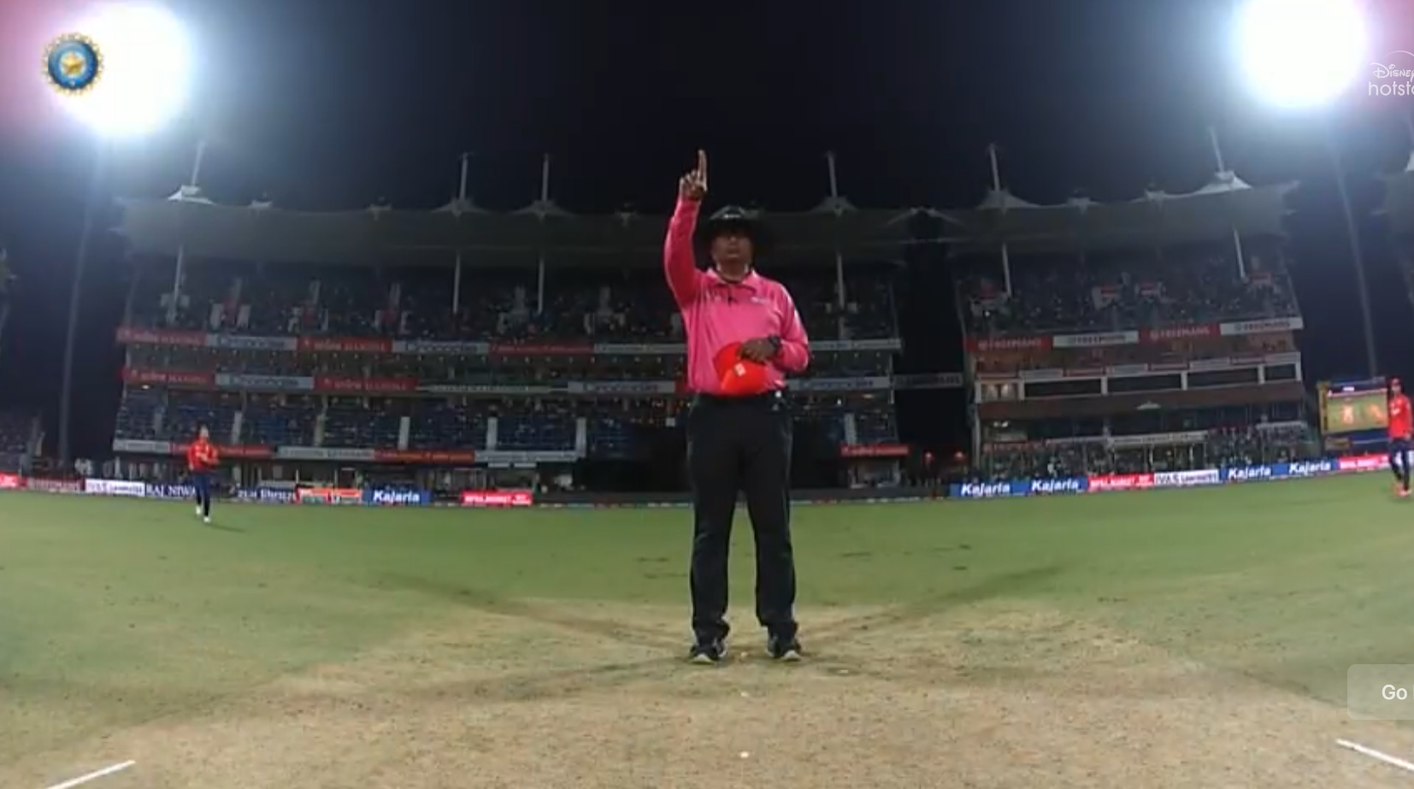
Created the dataset with 243.8 cm away from the webcam and the height of the webcam is nearly equals to 65 cm.
Focusing to target the camera in the bowler’s end stump for detecting umpire signals for real time application, we observed the height of the stump and the camera height from the ground and the dataset is been created.

Slide 27
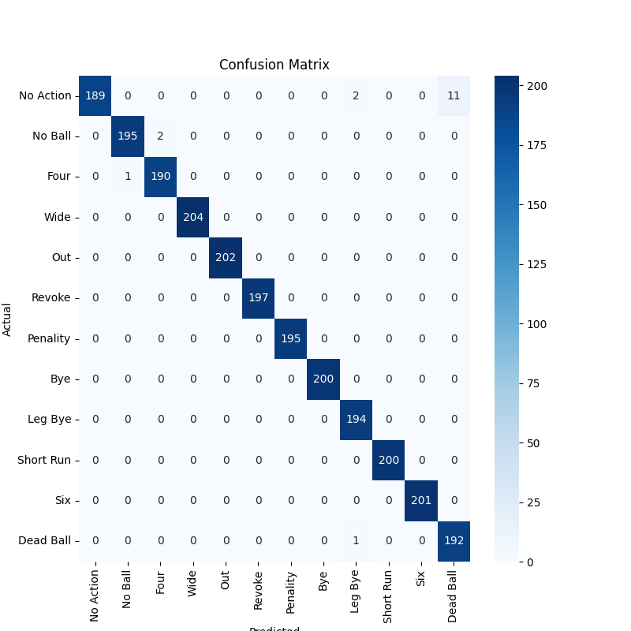
Confusion Matrix:
Epoch : 100
Dataset:
Training(%)= 80%
Test(%) = 20%

Slide 28
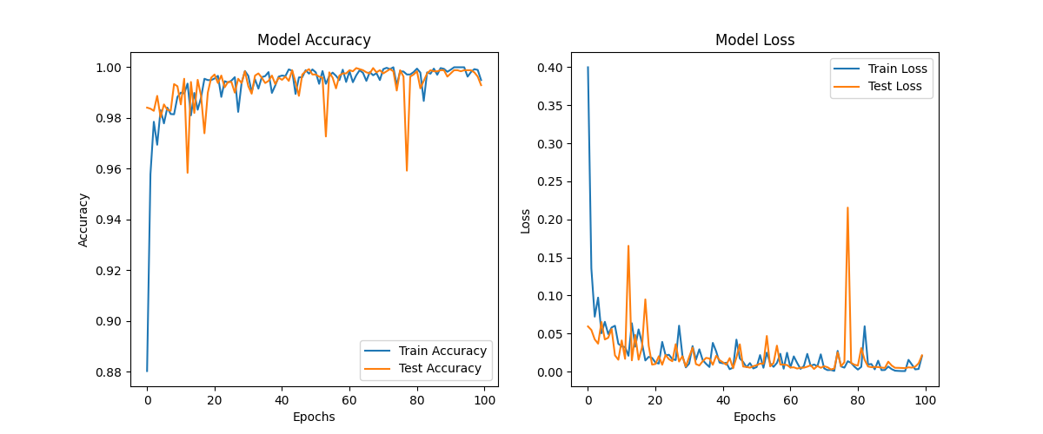
Accuracy & Loss Graph:

Slide 29
Performance Metrics:
Class | Precision | Recall | F1-Score | Accuracy
No Action | 1.00 | 0.94 | 0.97 | 0.9356
No Ball | 0.99 | 0.99 | 0.99 | 0.9898
Four | 0.99 | 0.99 | 0.99 | 0.9948
Wide | 1.00 | 1.00 | 1.00 | 1.0000
Out | 1.00 | 1.00 | 1.00 | 1.0000
Revoke | 1.00 | 1.00 | 1.00 | 1.0000
Penalty | 1.00 | 1.00 | 1.00 | 1.0000
Bye | 1.00 | 1.00 | 1.00 | 1.0000
Leg Bye | 0.98 | 1.00 | 0.99 | 1.0000
Short Run | 1.00 | 1.00 | 1.00 | 1.0000
Six | 1.00 | 1.00 | 1.00 | 1.0000
Dead Ball | 0.95 | 0.99 | 0.97 | 0.9948
🔹 Train Accuracy: 0.9975
🔹 Test Accuracy: 0.9928
🔹 Overall Accuracy: 0.9928

Slide 30
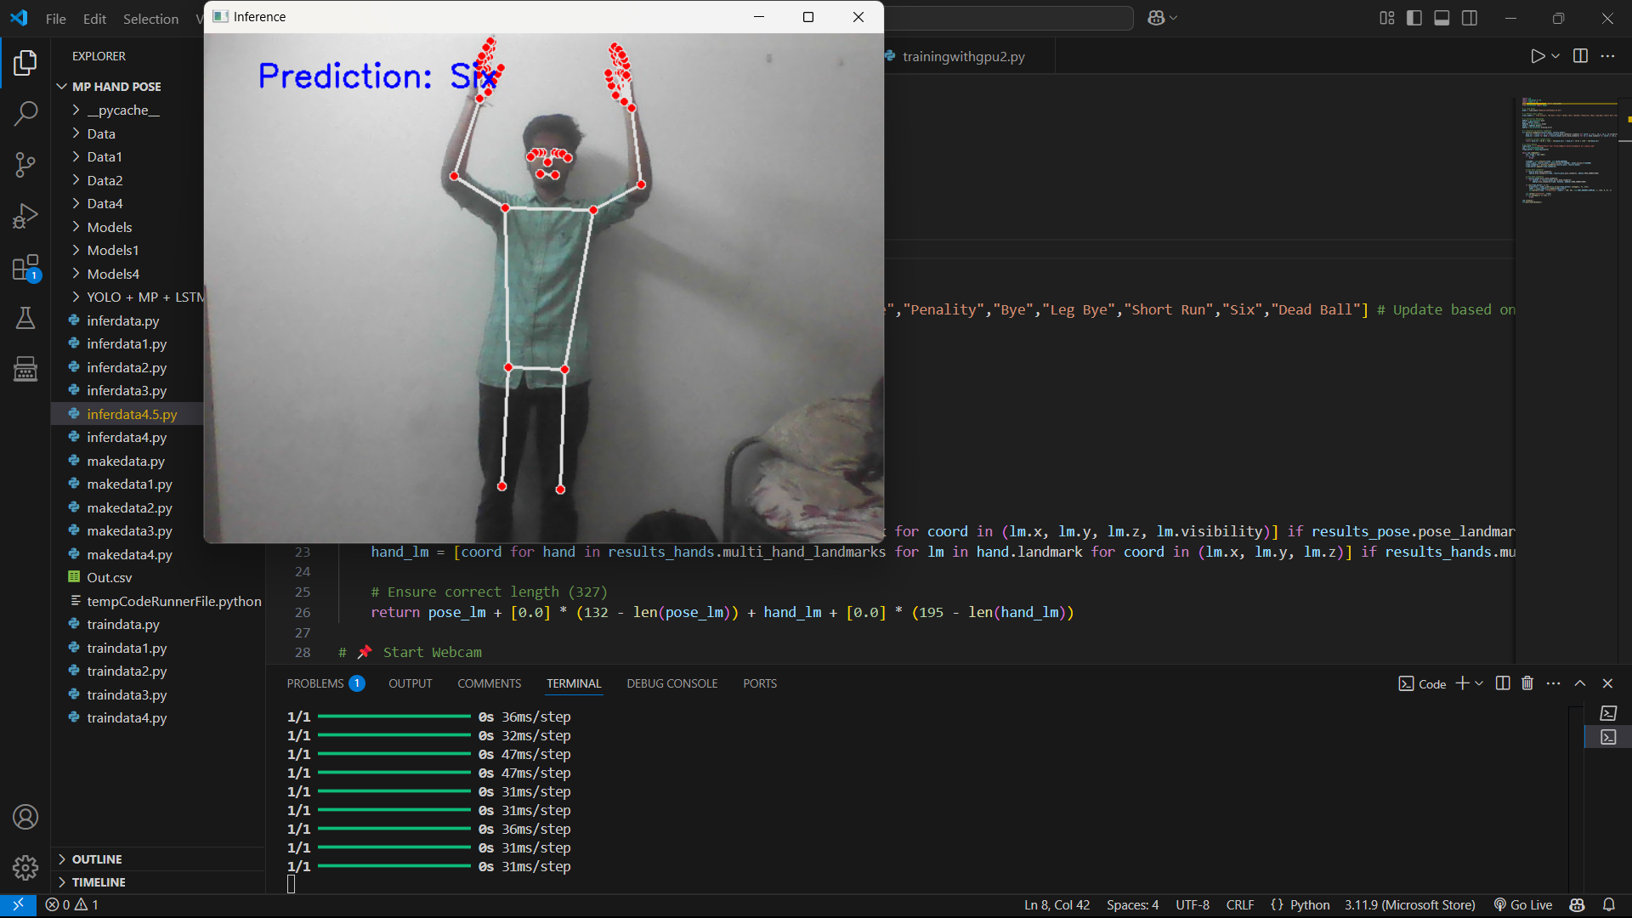
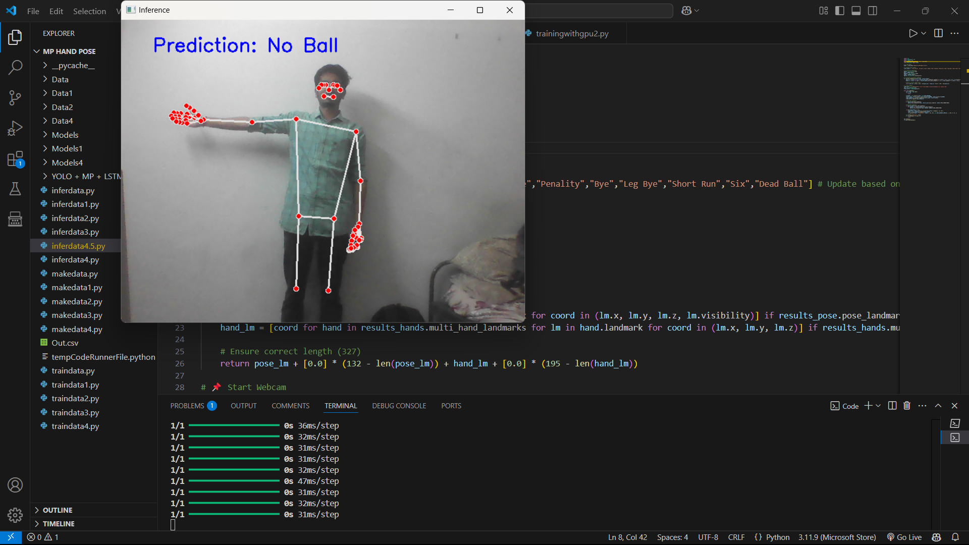
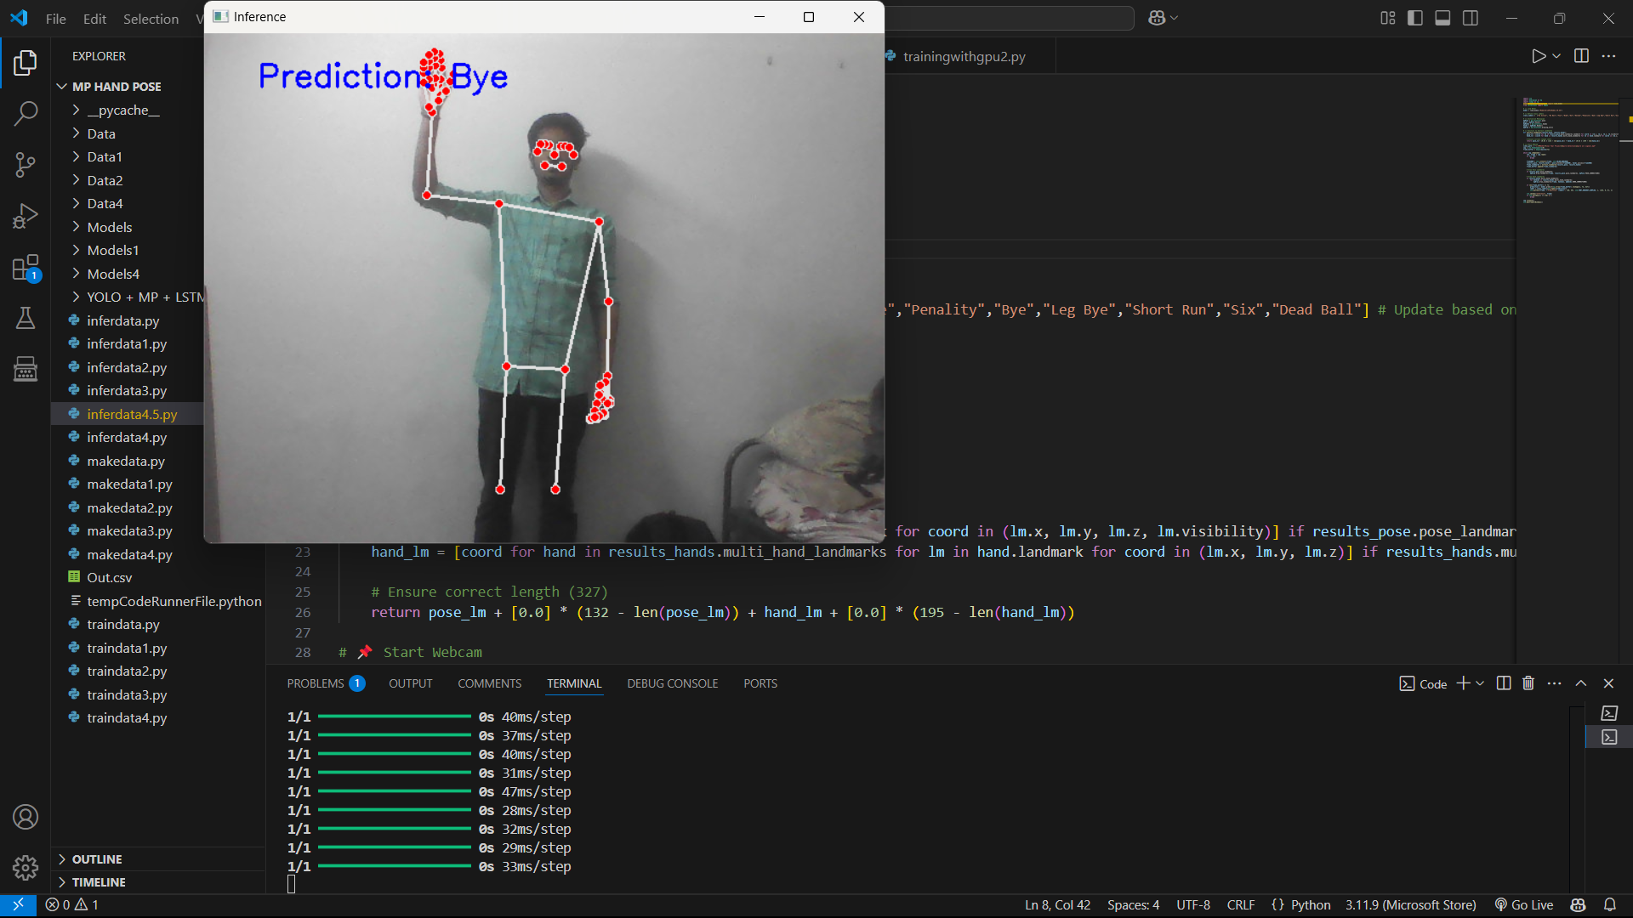
Real-Time Output(Methodology 2):

Slide 31
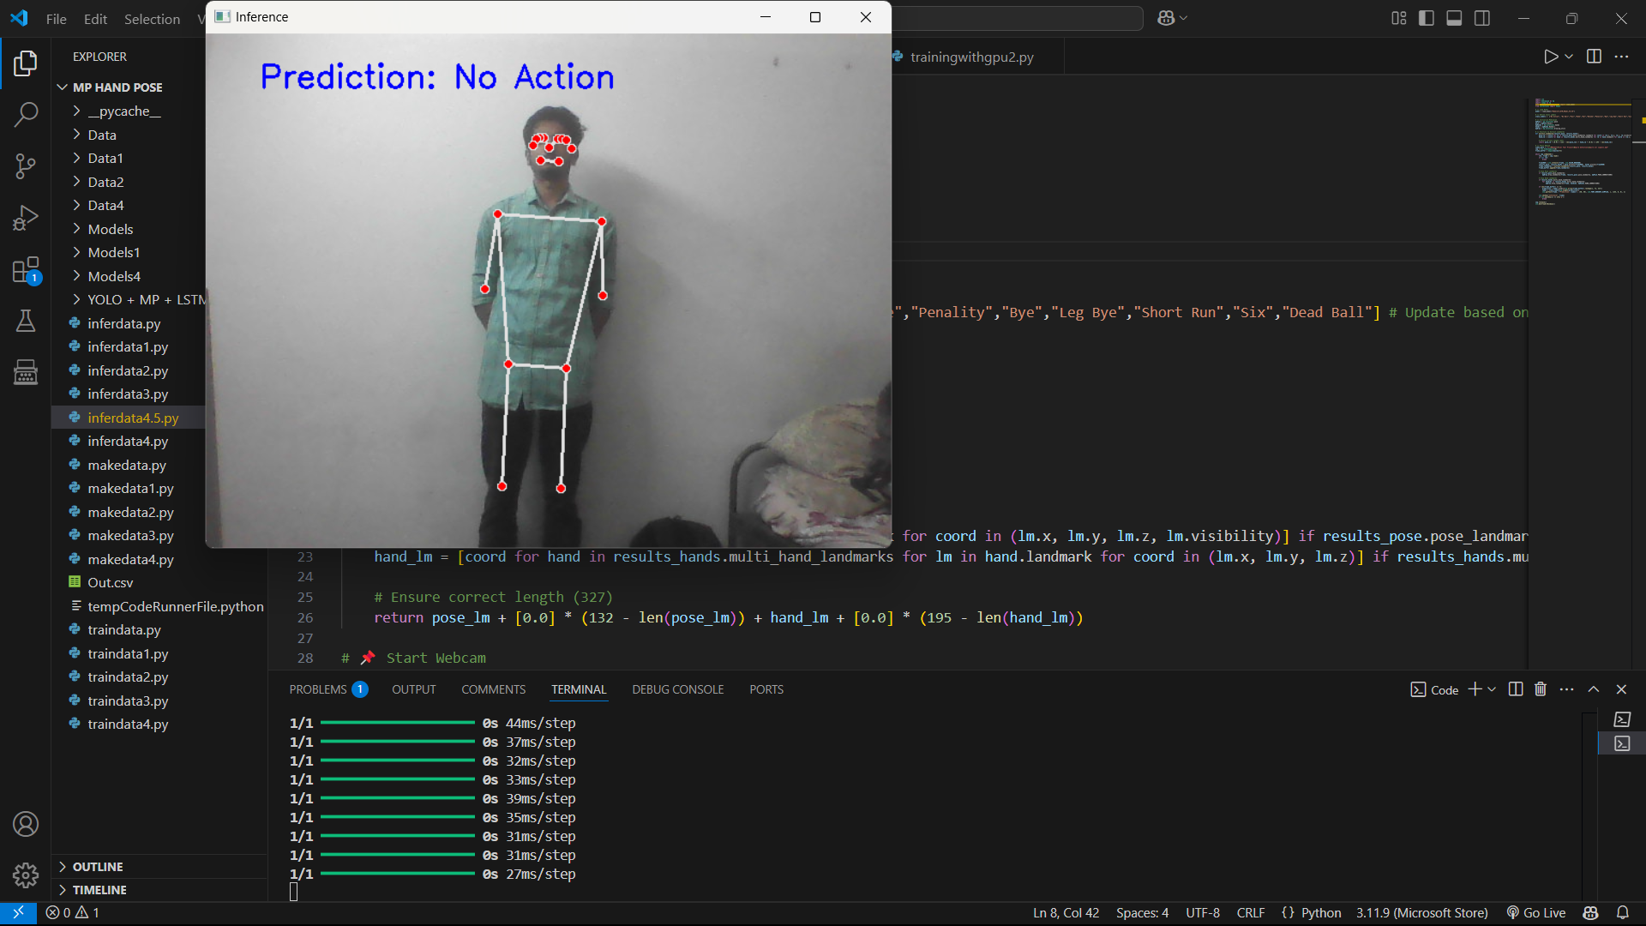

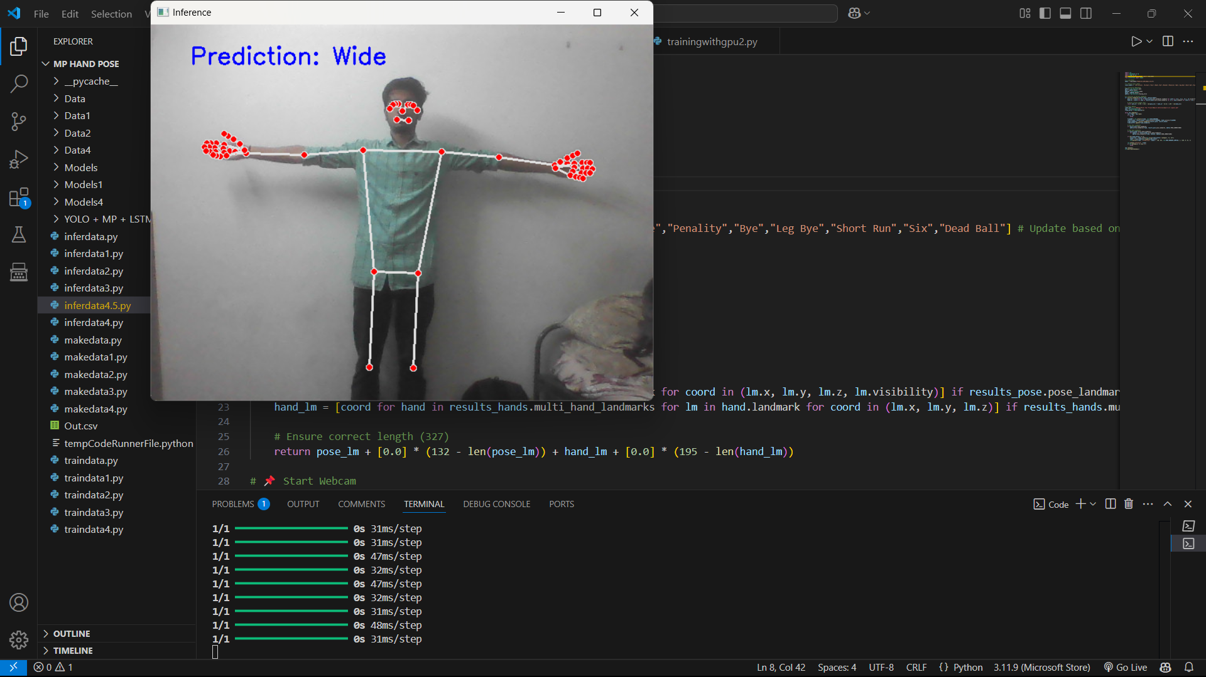
Real-Time Output(Methodology 2):

Slide 32
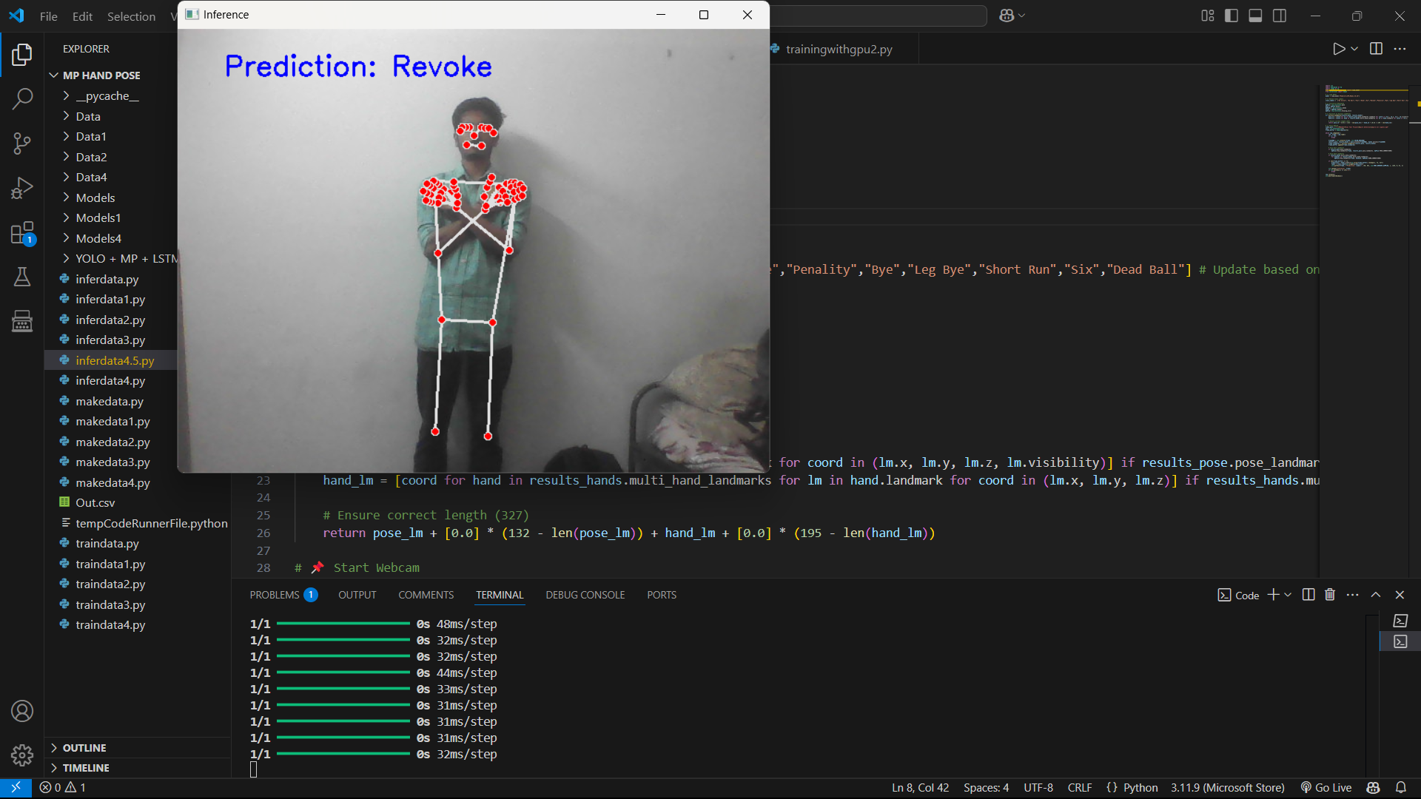
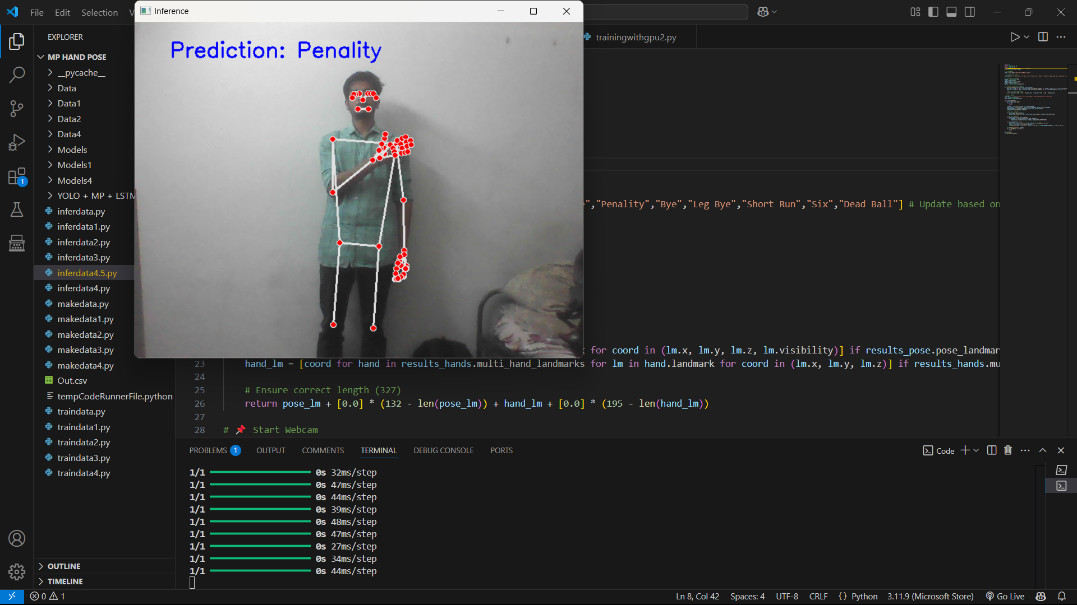
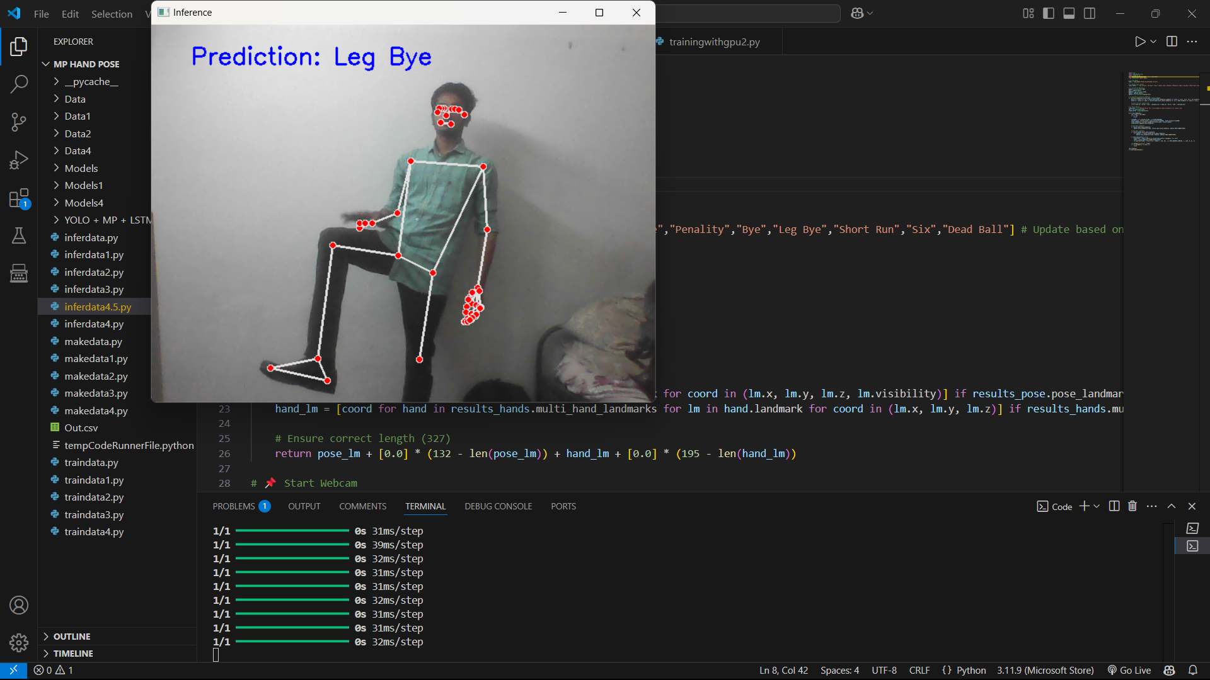
Real-Time Output(Methodology 2):

Slide 33
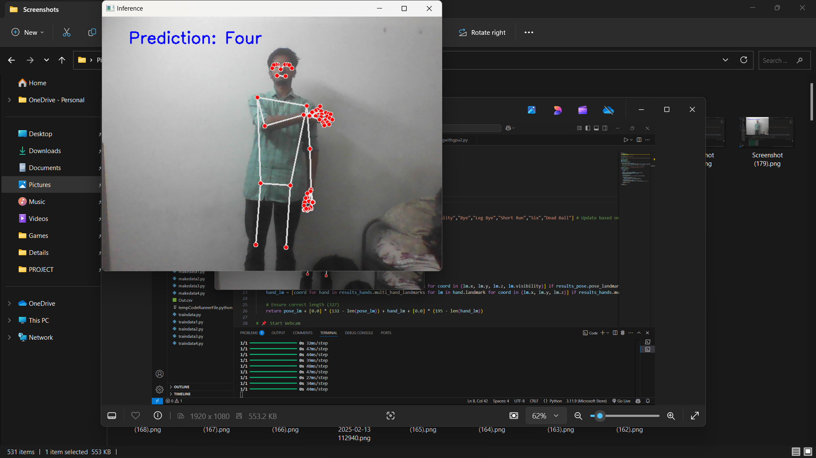
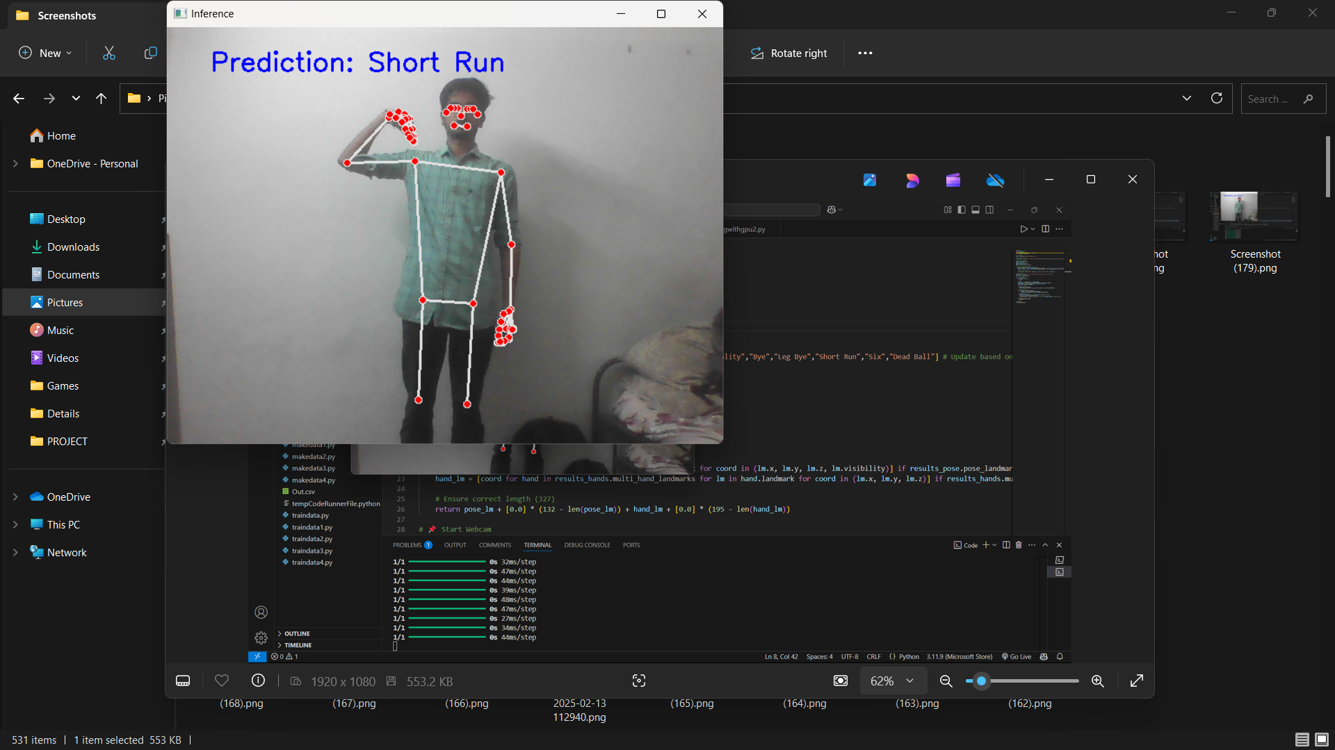
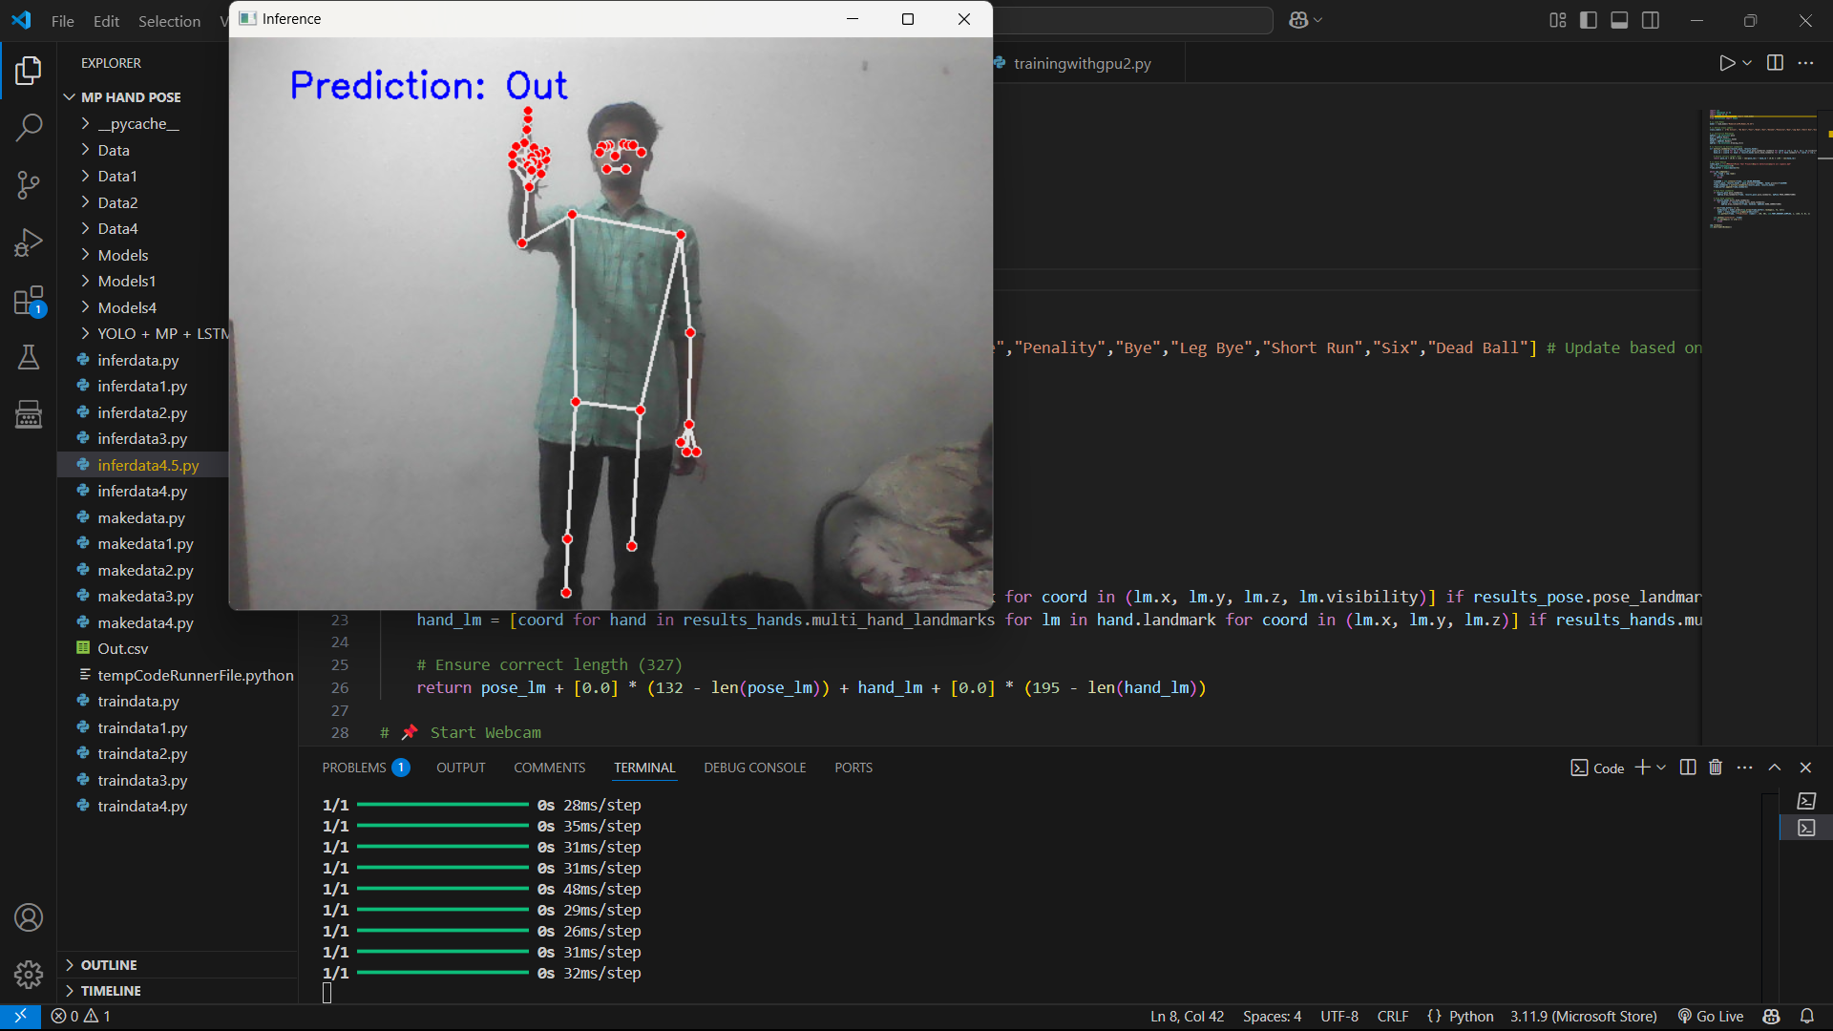
Real-Time Output(Methodology 2):

Slide 34
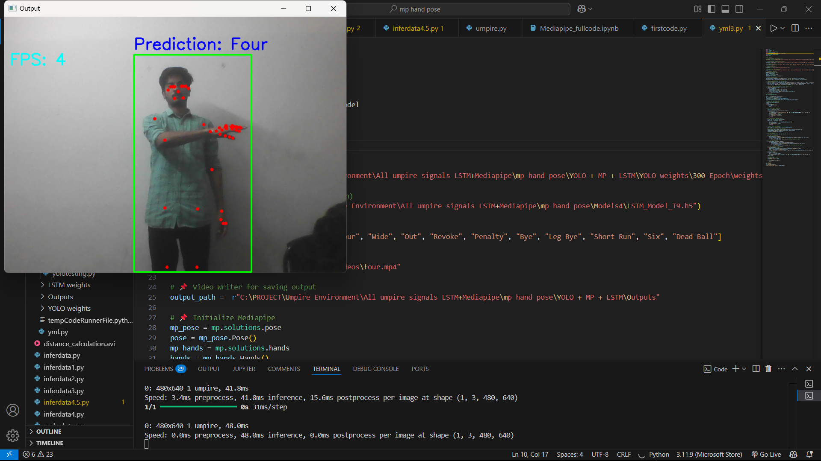
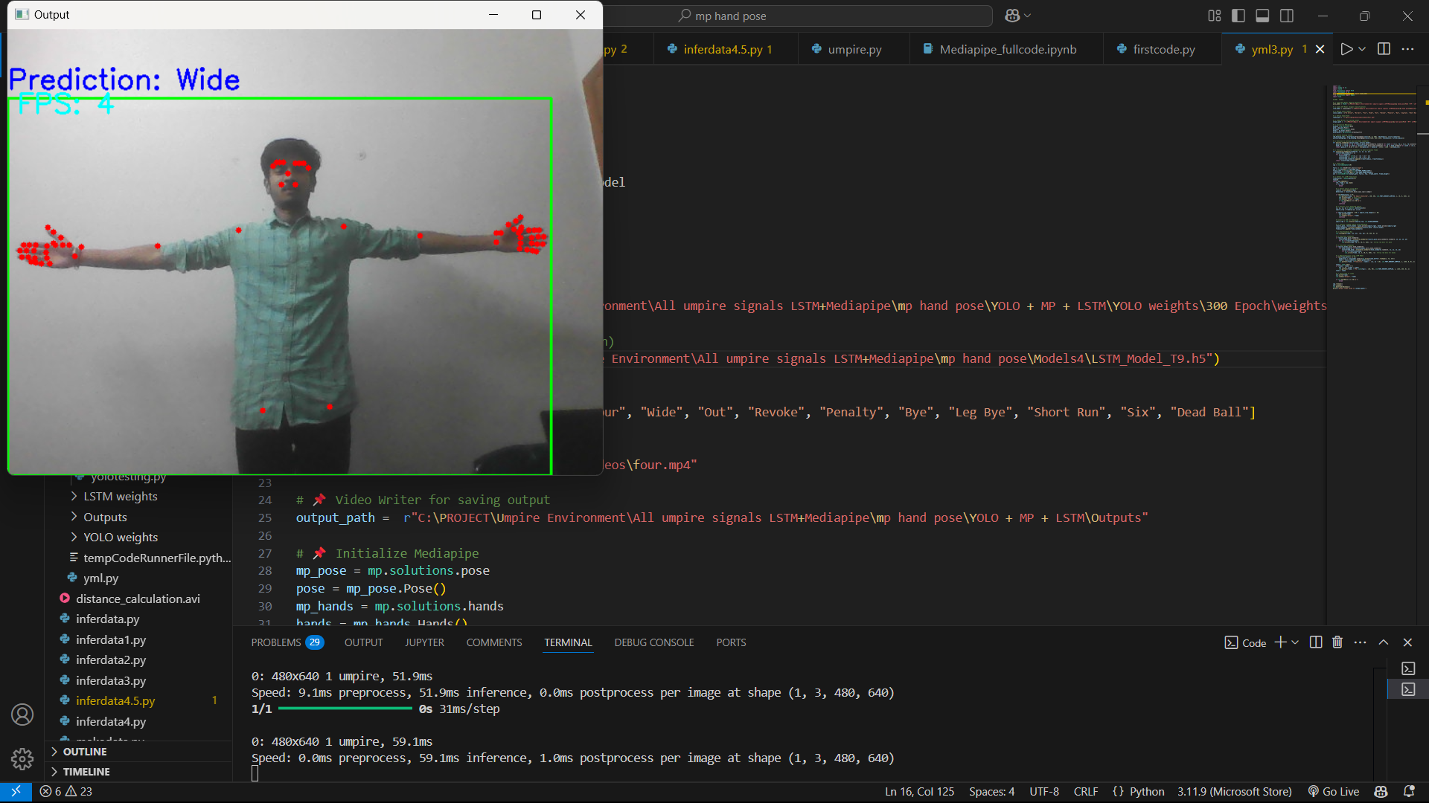
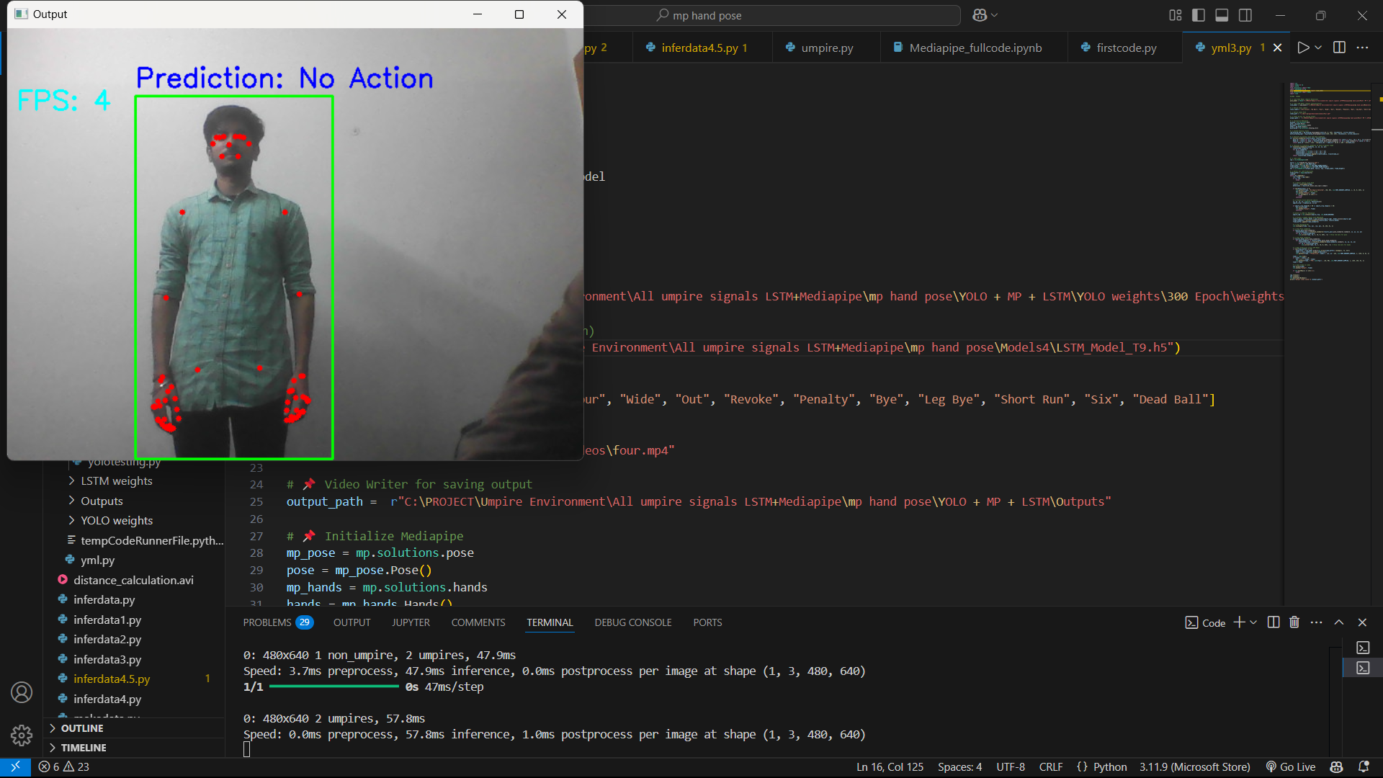

YOLO + MediaPipe + LSTM:
YOLO is combined with Mediapipe for recognition of umpire pose within the frame

Slide 35


Running Between Wickets:
The scores obtained by running can be calculated by obtaining the distance between the batsmen on both crease
It can be implemented using distance calculation by YOLOv8

Slide 36
Work done:-
Work in Progress:-
Work to be Done:-
Dataset was collected and trained by using YOLOv8 Model for classification of umpire and Non-umpire in a video frame.
Mediapipe is implemented for the classification of umpire signals based on the posture.
Inputs were given in the format of images, videos and the outputs were inferred accurately.
Real time feed was given using Web cam and the outputs were analysed.
Improving dataset to predict the signals even more accurate.
YOLOv8 and MediaPipe is being fused together along with LSTM.
Started trying for updating through Running between the wickets.
Comparison with other state of the art datasets will be done for further analysis.
Even more signals will be added.
The output will be fed to the score updating algorithm.
The LSTM model will be compared by altering the model.

Slide 37
Outcomes :
The hybrid YOLOv8 and MediaPipe with LSTM model will demonstrate higher accuracy in updating the score through umpire signals.
The model will generate clear and consistent recognition of umpire signals such as six, four, no ball, penalty, revoke, wide, wicket, etc.,
Automated updating will significantly reduce the time and error made by manual updating .

Slide 38
REFERENCES :
Yeong-Min Ko,Aziz Nasridinov,So-Hyun Park, ”Real-Time AI Posture Correction for Powerlifting Exercises Using YOLOv5 and Mediapipe” IEEE Access-(Volume: 12),2024.
A. Dey, S. Biswasa, L. Abualigah, "Umpire’s Signal Recognition in Cricket Using an Attention based DC-GRU Network" IJE TRANSACTIONS A: Basics Vol. 37 No. 04, (April 2024)
A. Suryavanshi, S. Mehta, et al, “Cricket Umpire Intelligence: A CNN-SVM Framework for Action Detection” 024 2nd World Conference on Communication & Computing (WCONF) Raipur, India. Jul 12-14, 2024
S. Sakib,Md. Afranul, et al.“Event Detection from Cricket Videos Using Video-Based CNN Classification of Umpire Signals”, 2022 4th International Conference on Sustainable Technologies for Industry 4.0 (STI), 17-18 December, Dhaka

Slide 39
Andre Jallen S. Ong, Melvin Cabatuan , et al., “LSTM-Based Traffic Gesture Recognition Using MediaPipe Pose”, IEEE region 10 Conference(TENCON), 2022
WJ Samaraweera, SC Premaratne, “Deep Learning for Classification of Cricket Umpire Postures”, Neural Image processing, 27th International Conference,ICONIP 2020.
Md. Kowsher, M Ashraful Alam, et al.,”Detecting Third Umpire Decisions And Automated Scoring System for Cricket. ”, International Conference on Computer, Communication, Chemical, Materials and Electronic Engineering (IC4ME2), 11-12 July, 2019
Aravind Ravi, H. Venugopal, et al. ‚‘‘ A Dataset and Preliminary Results for Umpire Pose Detection Using SVM Classification of Deep Features” IEEE Symposium Series on Computational Intelligence SSCI, 2018
Shamitha S H, “Sign Language Recognition Utilizing LSTM And MediaPipe For Dynamic Gestures Of ISL”, International Journal for Multi disciplinary Research, 2023

